Slide 1
THIS IS A PRESENTATION ABOUT THE ETL (EXTRACT, TRANSFORM AND LOAD) PROCESS, DATA CLEANING AND PREPARATION OF REPORT USING MS EXCEL.

Slide 2
THE DATASET IS SENT BY THE CONTROLLING OFFICE FOR MONITORING AND FOLLOW-UP OF THE BRANCHES TO IMPROVE THE GROWTH AND PERFORMANCE IN THE AREA OF SMALL AND MEDIUM ENTERPRISES (SME) ADVANCES THROUGH BUSINESS RULE ENGINEERING (BRE) MODEL DEVELOPED BY THE BANK.

Slide 3
THE DATASET CONTAINS INFORMATION ABOUT CUSTOMERS WHICH IS SENSITIVE IN NATURE AND CANNOT BE TRANSFERRED TO EXTERNAL EMAIL DUE TO DATA PROTECTION POLICY OF THE BANK. SCREENRECORDING ALSO RESTRICTED. THEREFORE, SCREENSHOTS OF THE DATA ANALYSIS PROCESS IS TAKEN AND COMBINED TO PREPARE A VIDEO PRESENTATION. THE PURPOSE IS TO SHOW IN PORTFOLIO PROJECT THE KIND OF ANALYSIS I DO ON DAILY BASIS.

Slide 4

INFORMATION ABOUT DATASETS:
THERE ARE TWO DATASETS WHICH ARE TO BE WORKED UPON: ONE DATASET CONSISTS LOAN SANCTION DETAILS FROM LIMIT RS.10 LAKH TO 50 LAKH AND THE OTHER ONE CONTAINS SANCTION DETAILS WITH LOAN LIMIT RS. 50 LAKH TO 5 CRORES.
(1 MILLION= 10 LAKH, 10 MILLION = 1 CRORE)
ABBREVIATIONS TO BE NOTED:
CPC = CENTRALISED PROCESSING CELL
OUR MODULE NAME IS BIDHANNAGAR WHICH CONSISTS 11 CPCs AND OTEHR BRANCHES.
RACC= RETAIL ASSET CENTRALISED PROCESSING CELL.
RACCs ARE RECENTLY RENAMED AS AMCC.
AMCC= AGRI AND SME CENTRALISED PROCESSING CELL.
SMECC= SME CENTRALISED PROCESSING CELL.

Slide 5
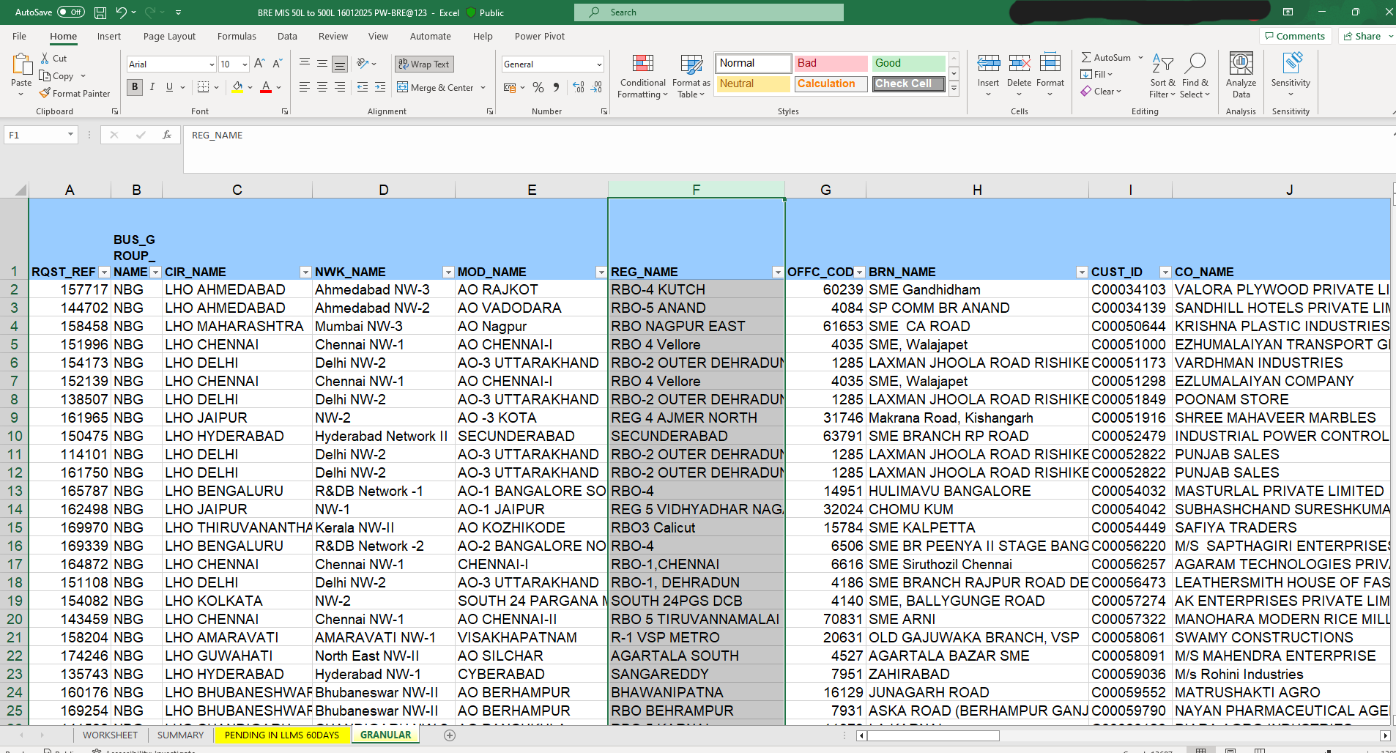
THIS TABLE CONTAINS INFORMATION OF LOANS SANCTIONED THROUGH BRE PROCESS FOR LOAN LIMIT 50 LAKH TO 5 CRORES.

Slide 6

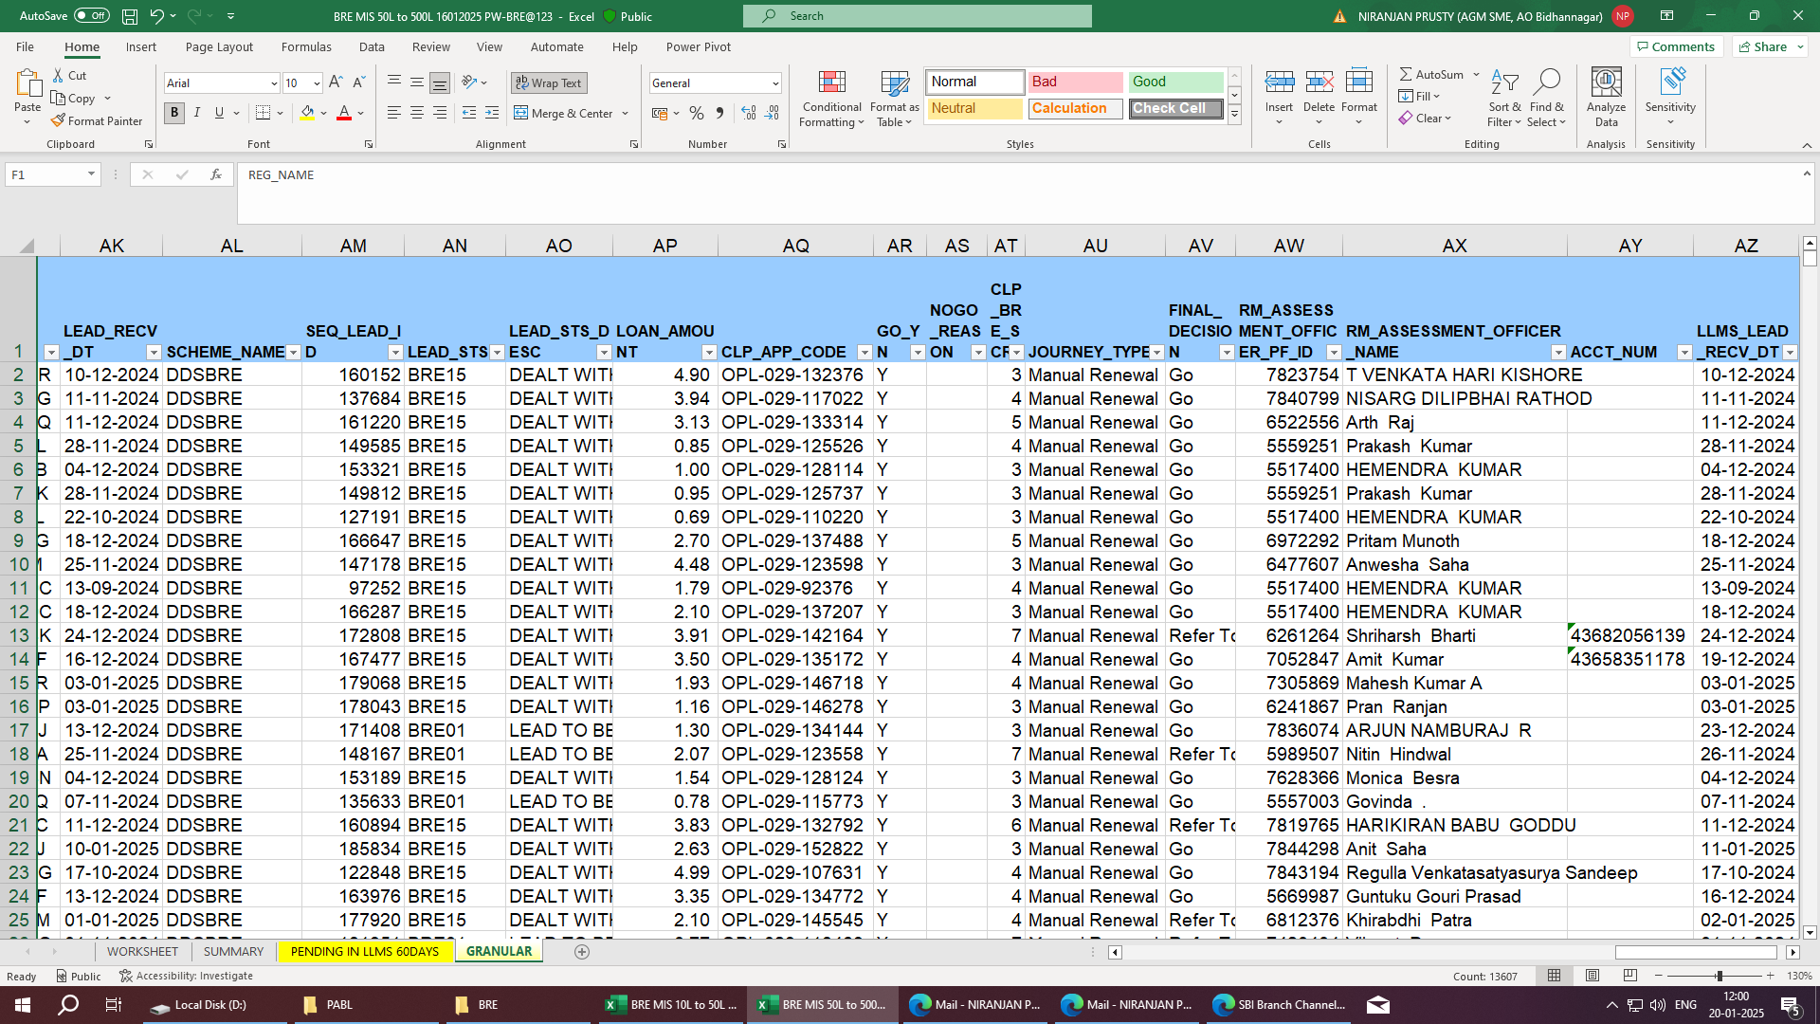
WE ARE INTERESTED IN COLUMNS WHICH CONTAINS DETAILS OF MODULE NAME, CPC NAME, CUSTOMER ID, SANCTION DATE, TOTAL EXPOSURE, JOURNEY TYPE ONLY.

Slide 7
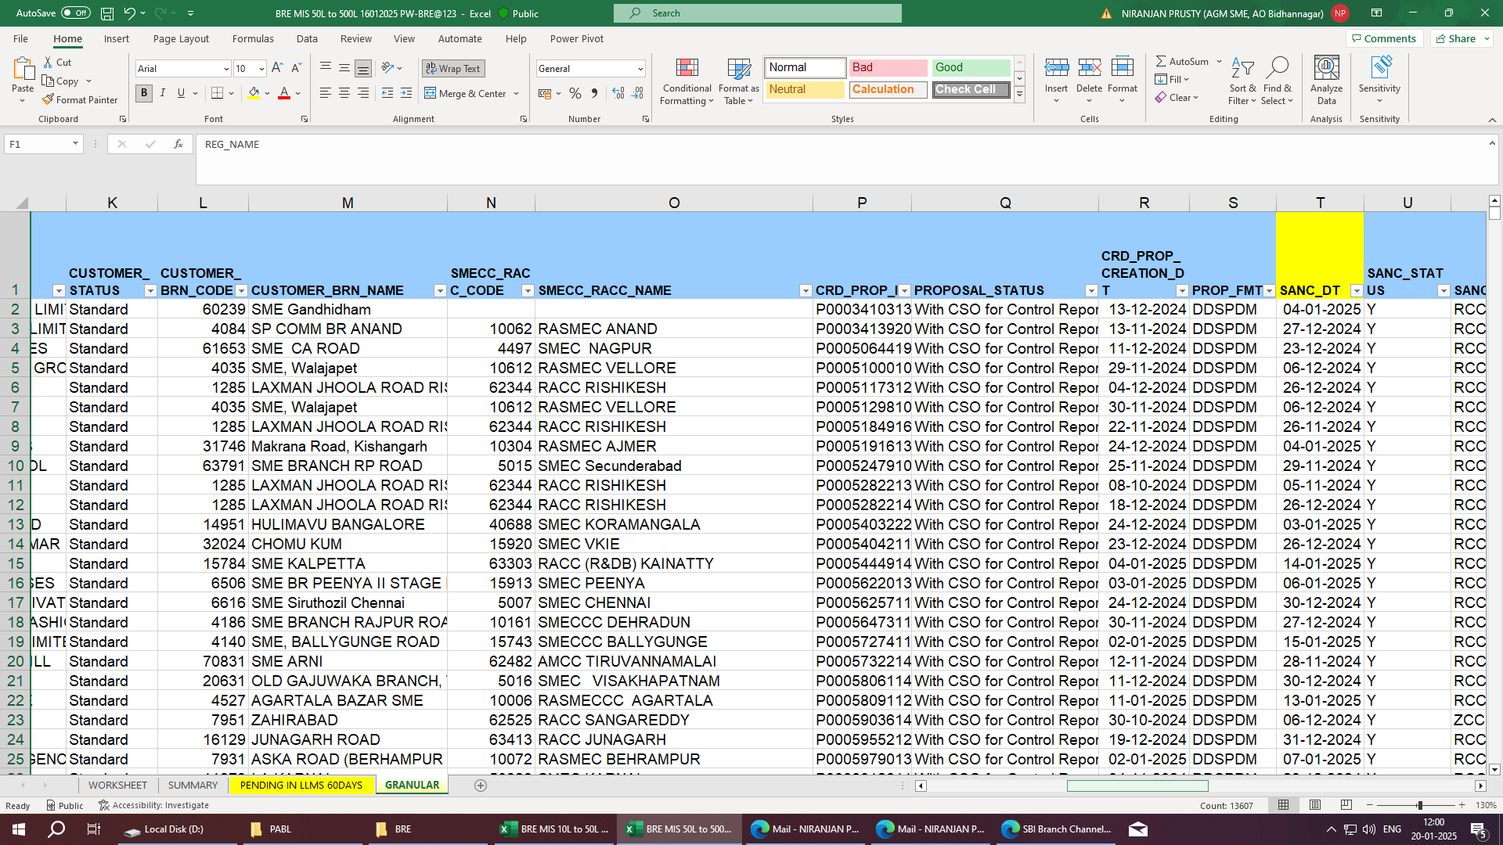
WE ARE INTERESTED IN COLUMNS WHICH CONTAINS DETAILS OF MODULE NAME, CPC NAME, CUSTOMER ID, SANCTION DATE, TOTAL EXPOSURE, JOURNEY TYPE ONLY.

Slide 8
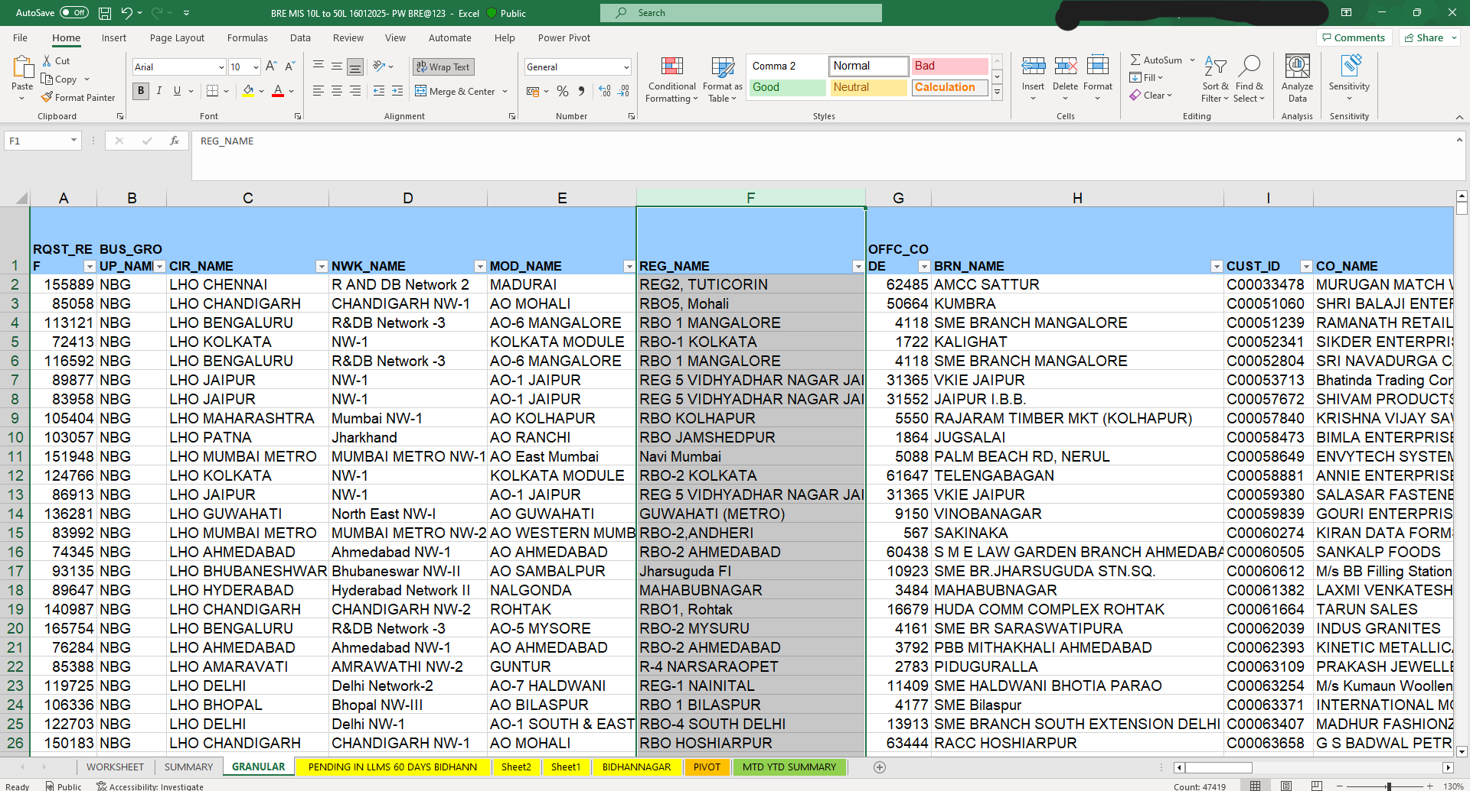
THIS TABLE CONTAINS INFORMATION OF LOANS SANCTIONED THROUGH BRE PROCESS FOR LOAN LIMIT 10 LAKH TO 50 LAKH.

Slide 9
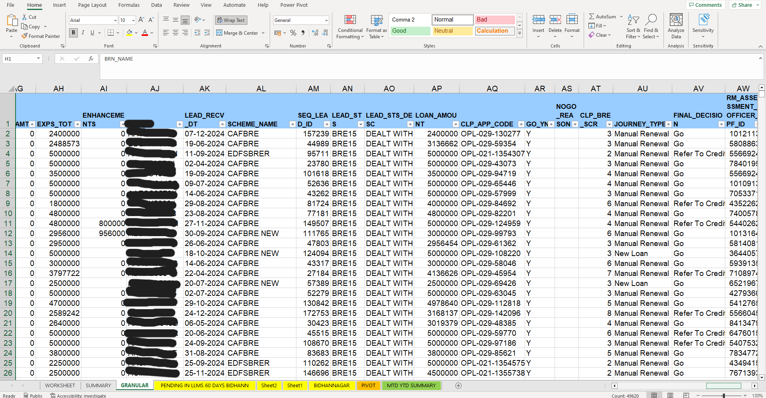
WE ARE INTERESTED IN COLUMNS WHICH CONTAINS DETAILS OF MODULE NAME, CPC NAME, CUSTOMER ID, SANCTION DATE, TOTAL EXPOSURE, JOURNEY TYPE ONLY.

Slide 10
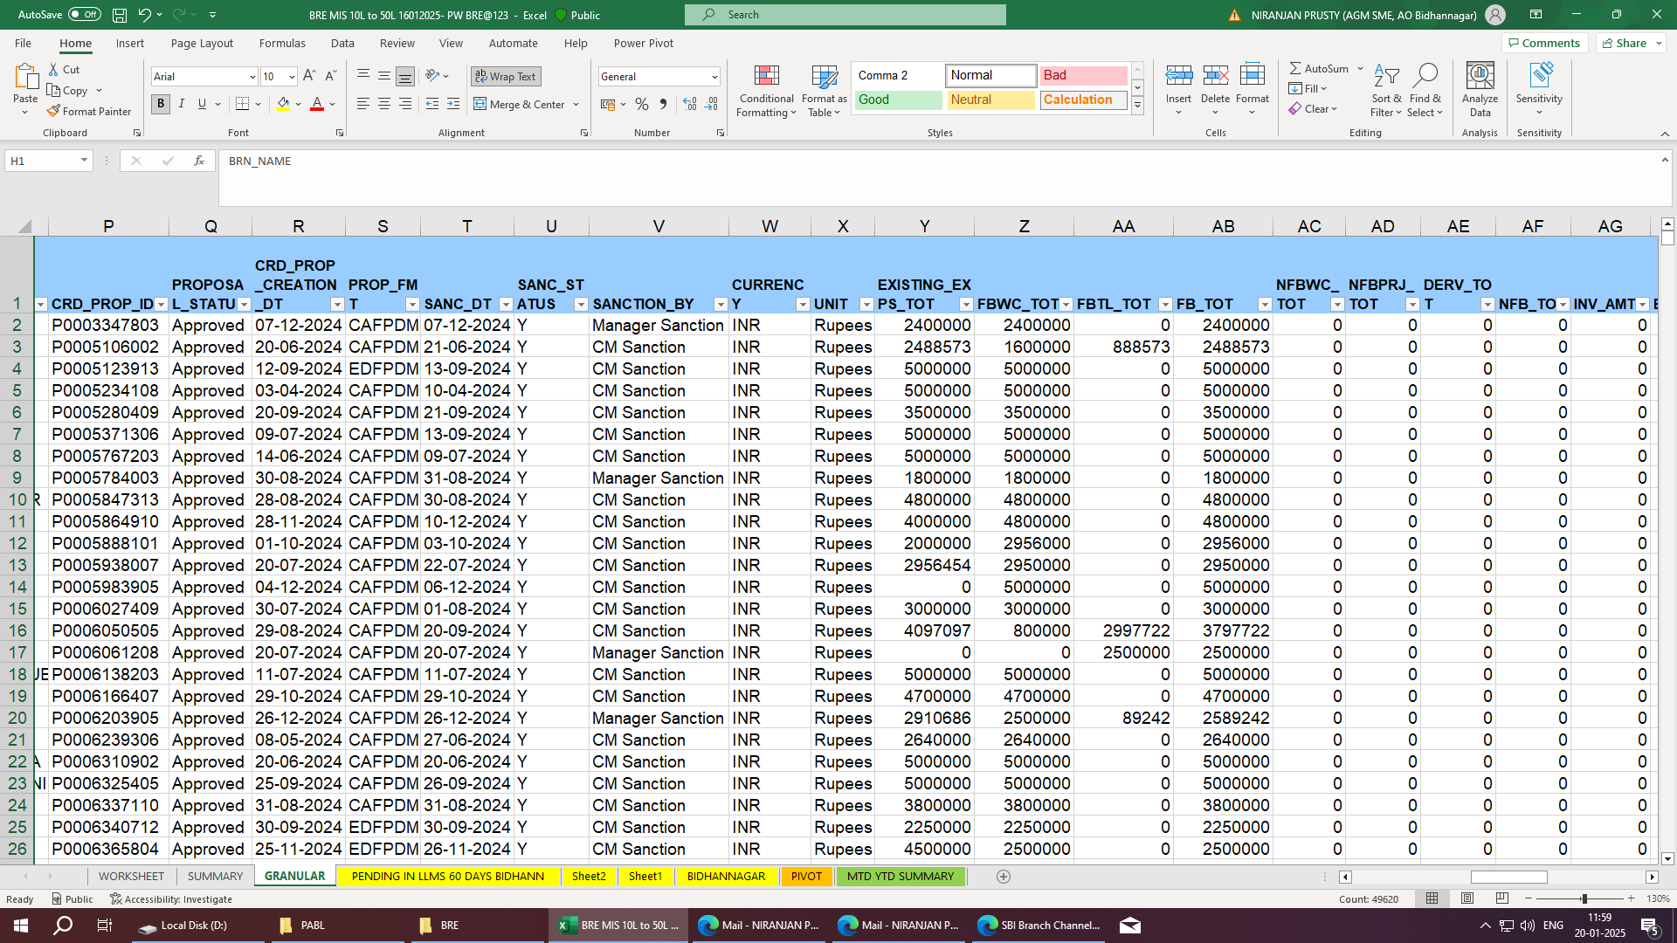
WE ARE INTERESTED IN COLUMNS WHICH CONTAINS DETAILS OF MODULE NAME, CPC NAME, CUSTOMER ID, SANCTION DATE, TOTAL EXPOSURE, JOURNEY TYPE ONLY.

Slide 11
INFORMATION ABOUT THE DATASETS:
MOD_NAME : CONSISTS DIFFERENT MODULE NAME. WE SHALL WORK WITH MODULE BIDHANNAGAR ONLY.
CUST_ID : 9 DIGIT CODE FOR EACH CUSTOMER.
SMECC_RACC_CODE = CODE FOR THE RESPECTIVE CPC.
SMECC_RACC_NAME = NAME FOR THE RESPECTIVE CPC.
SANC_DT : DATE OF SANCTION OF LOAN.
EXPS_TOT: TOTAL AMOUNT OF LOAN SANCTIONED.
JOURNEY TYPE :
NEW LOAN- NEW LOAN SANCTIONED WHERE CUSTOMER IS NEW-TO-BANK(NTB).
MANUAL RENEWAL - ANNUAL RENEWAL/ LIMIT ENHANCEMENT DONE
WHERE CUSTOMER IS EXISTING-TO-BANK(ETB).

Slide 12
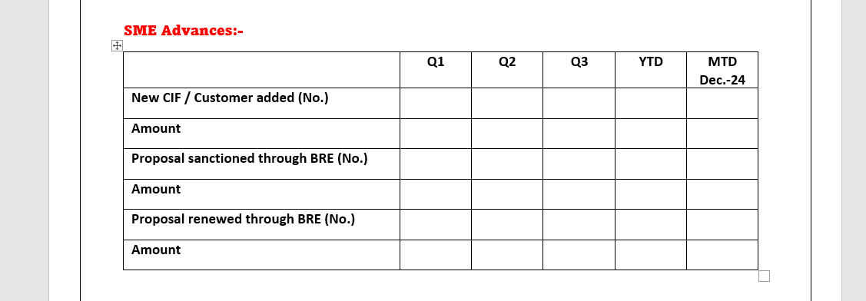
REPORT THAT NEEDS TO BE PREPARED
ALONG WITH THIS A CPCWISE SUMMARY TO BE PREPARED

Slide 13
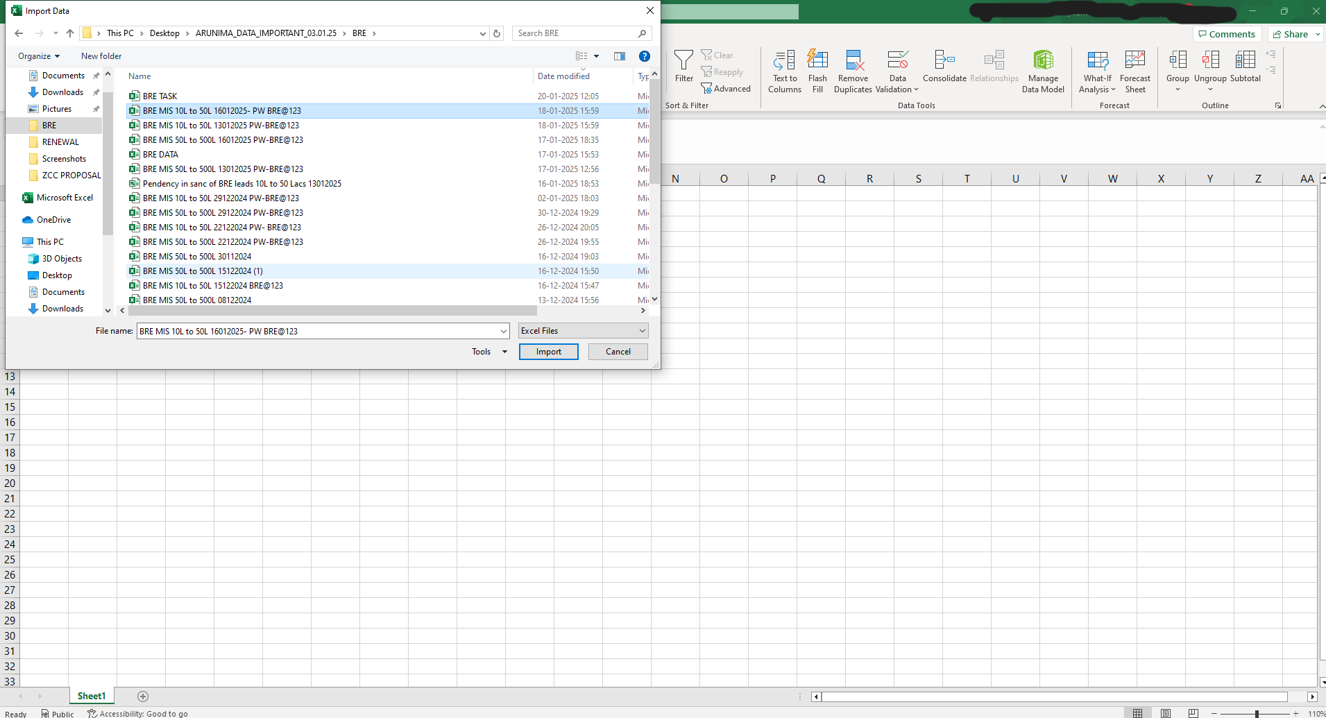
A NEW EXCEL WORKBOOK CREATED AND THE EXCEL FILE FOR 10-50 LAKH SELECTED FOR IMPORT IN POWER QUERY

Slide 14
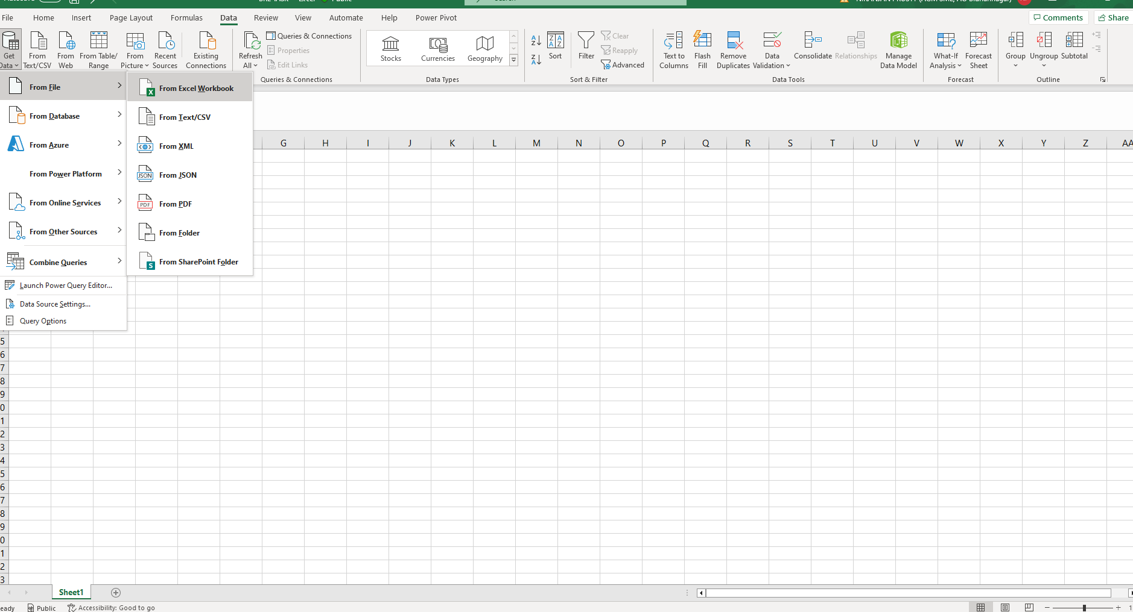
PATH- DATA--> GET DATA--> FROM FILE--> FROM EXCEL WORKBOOK

Slide 15
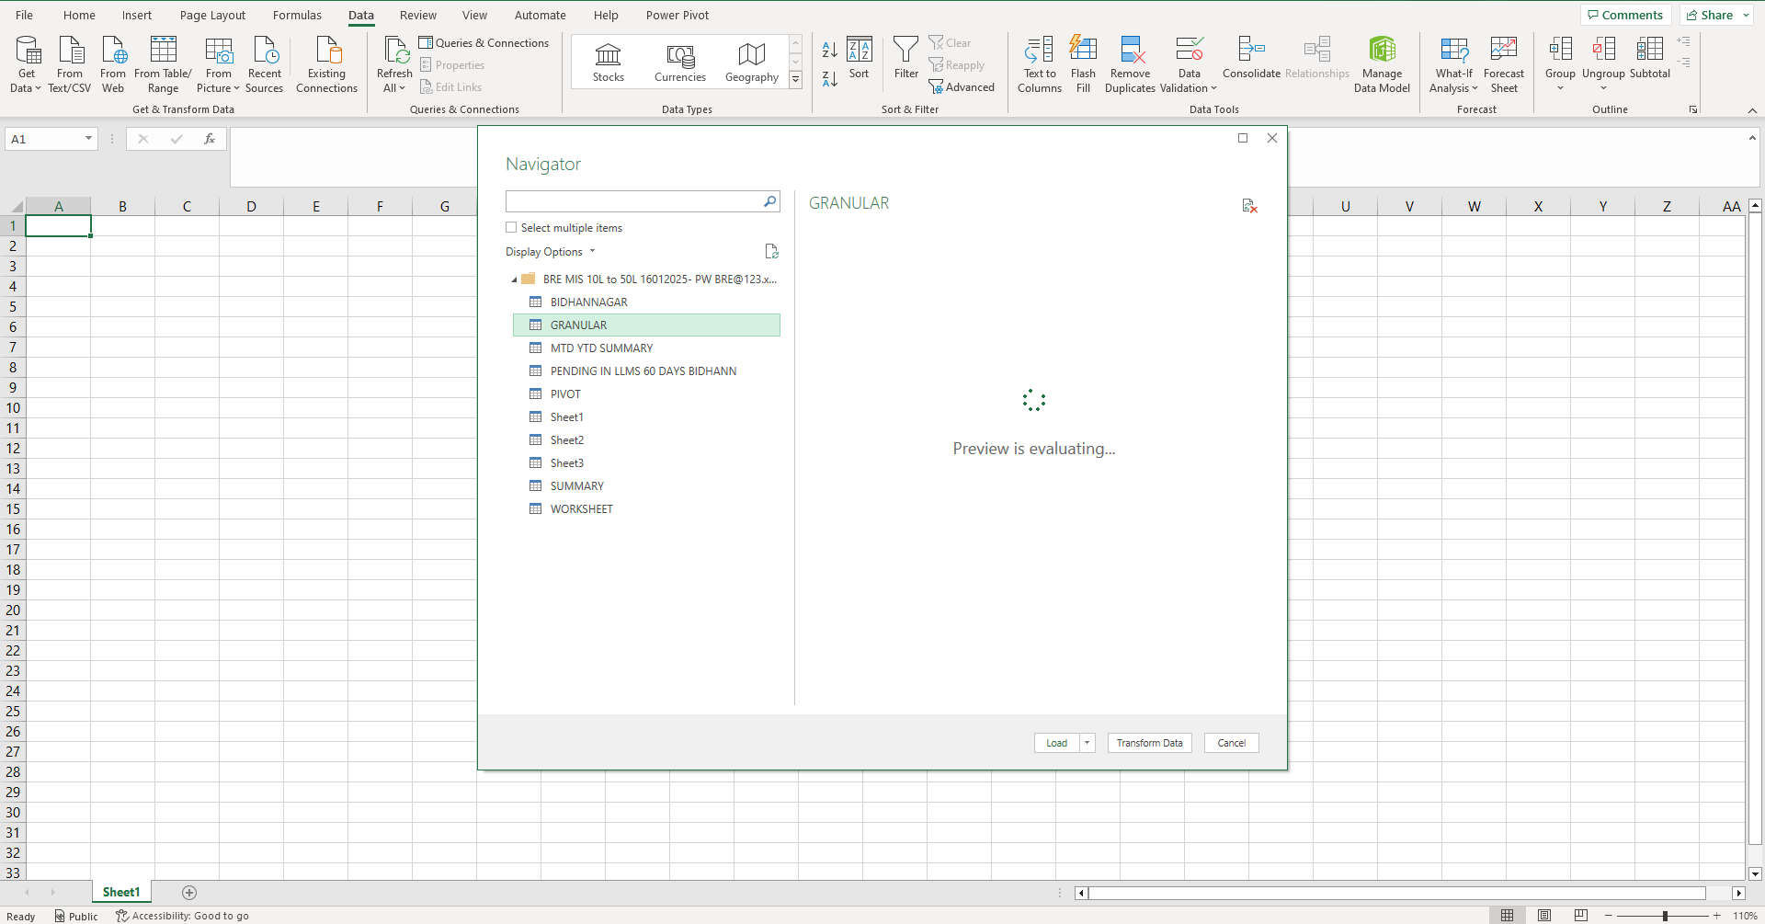
THE FILE IS LOADED FOR TRANSFORMATION AND “GRANULAR” WORKSHEET IS SELECTED

Slide 16
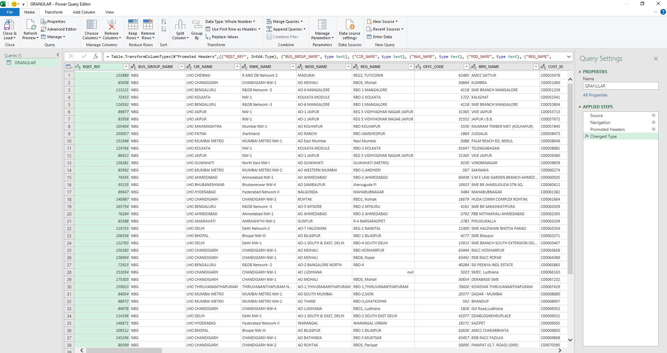
THE TABLE AFTER LOADING IN POWER QUERY

Slide 17
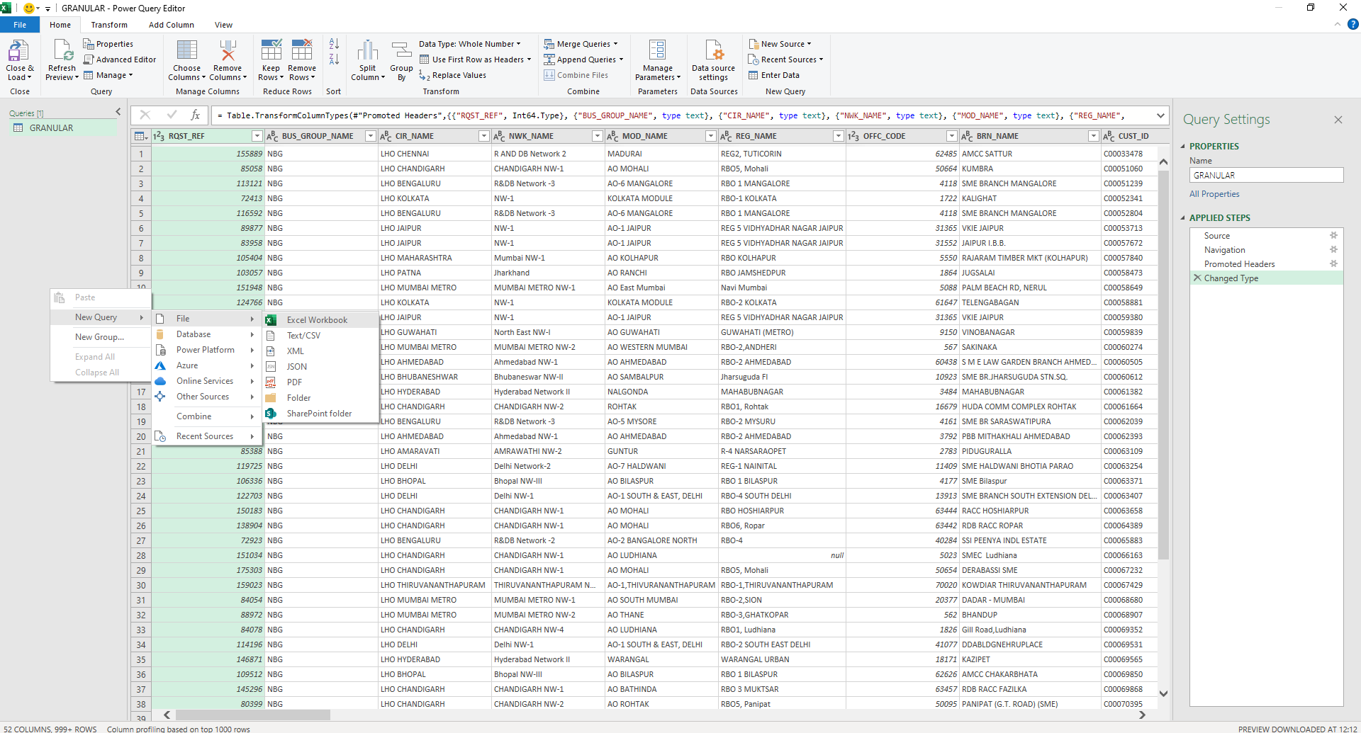
NEW BLANK QUERY CREATED TO LOAD GRANULAR TABLE FOR 50 LAKH

Slide 18
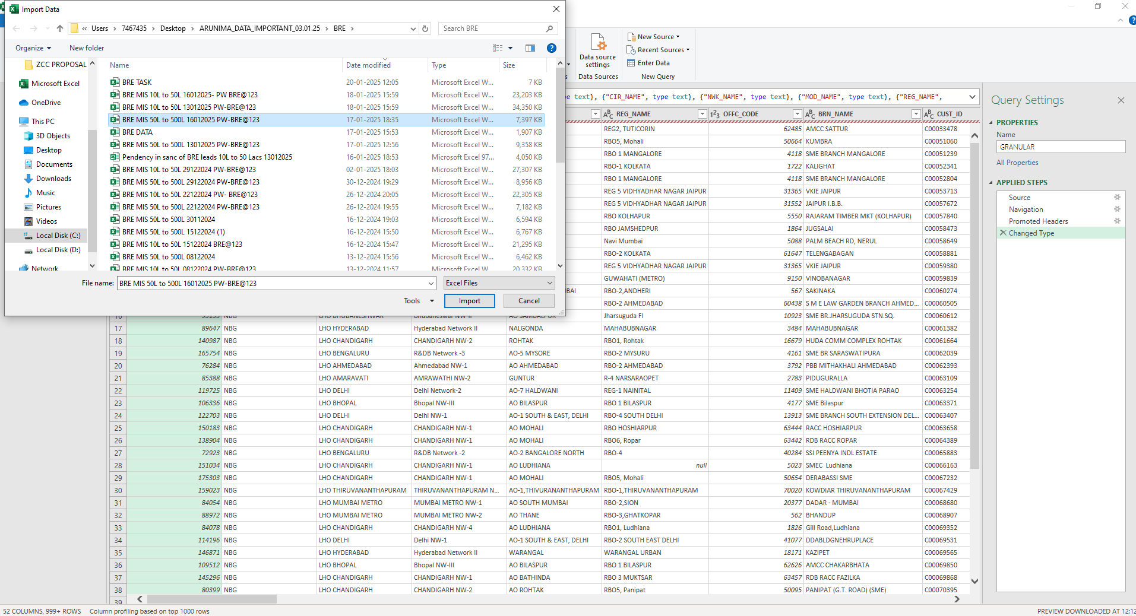
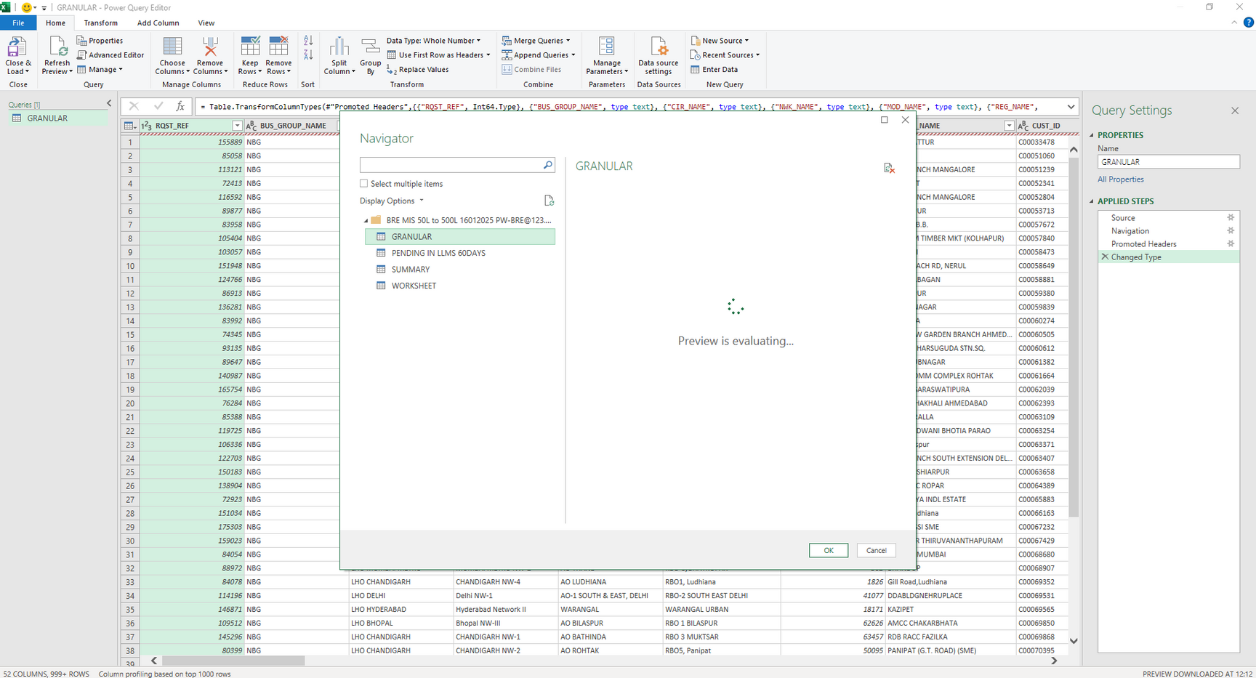
THE MAIN FILE IMPORTED AND THE “GRANULAR” WORKSHEET SELECTED TO LOAD IN THE BLANK QUERY

Slide 19
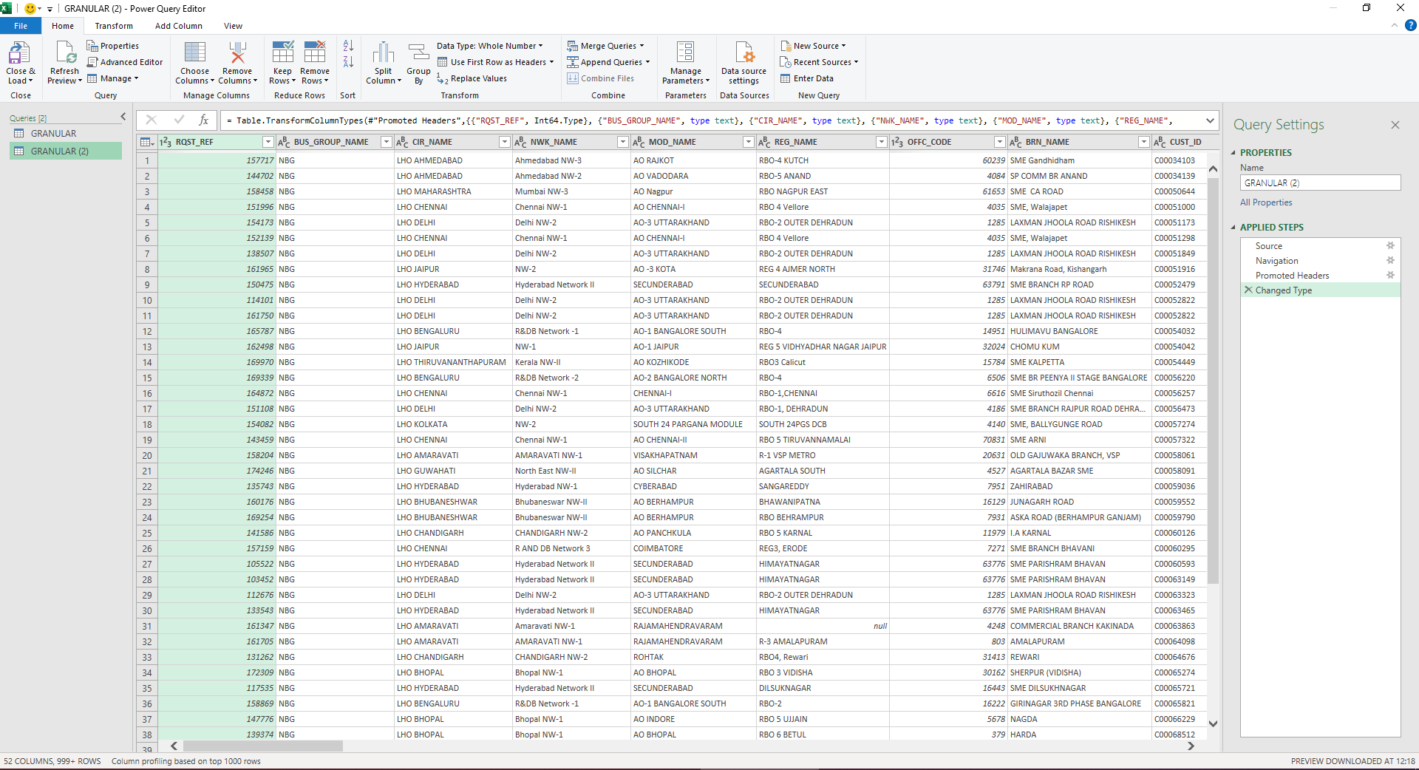
THE 2ND TABLE LOADED IN THE QUERY AND READY FOR TRANSFORMATON

Slide 20
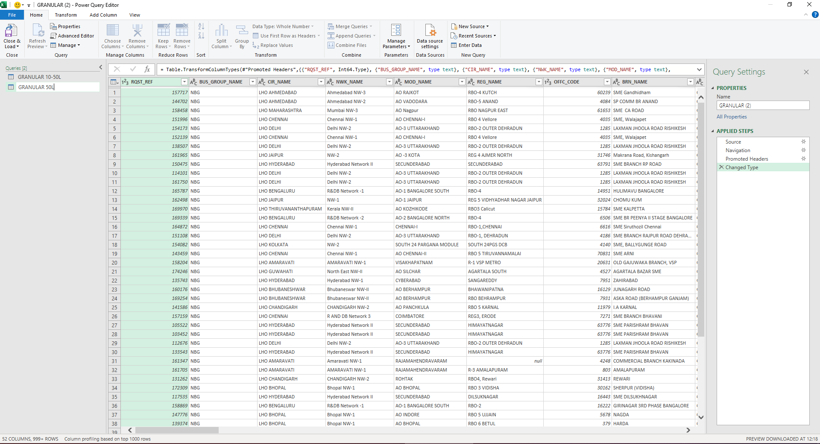
THE TABLES ARE RENAMED ACCORDINGLY

Slide 21
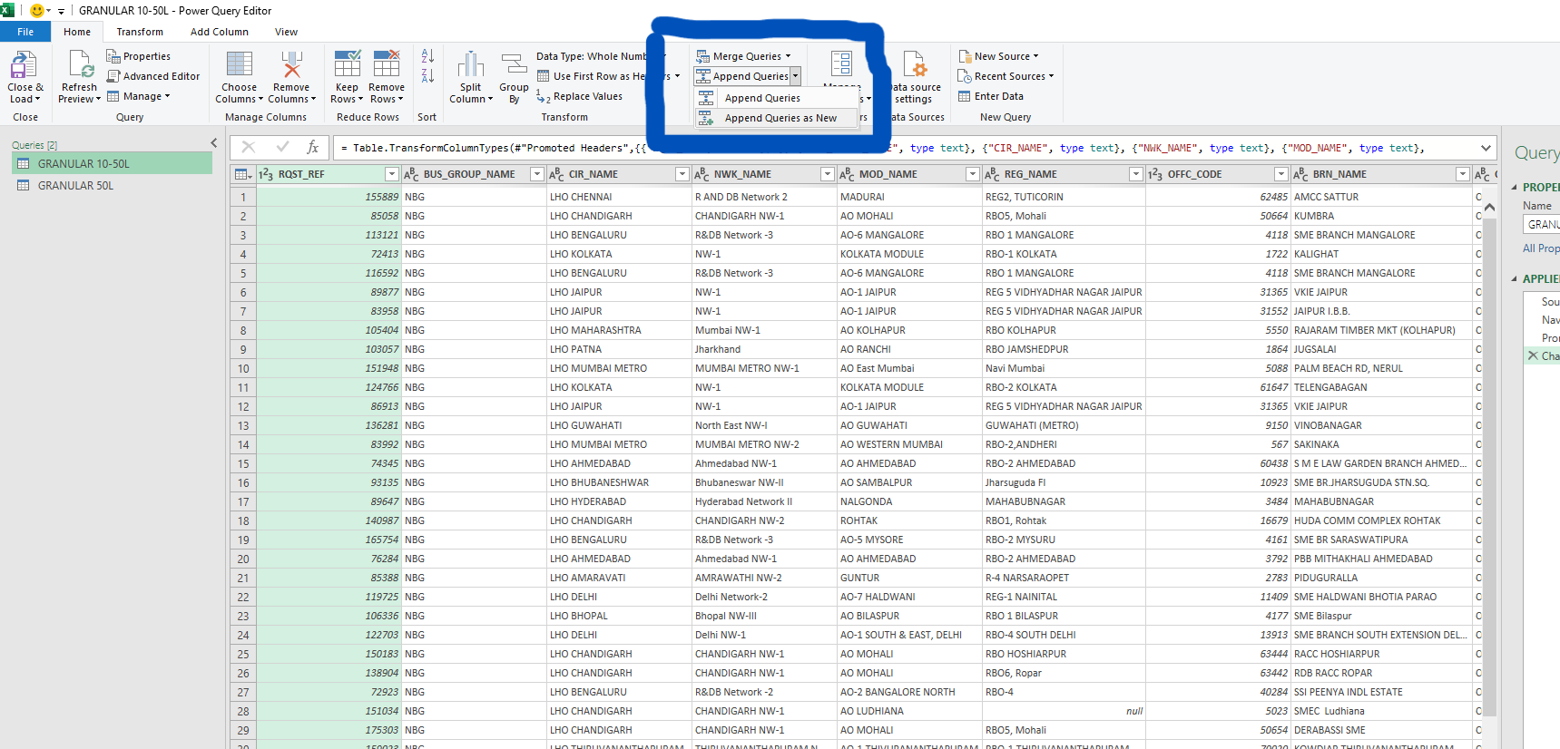
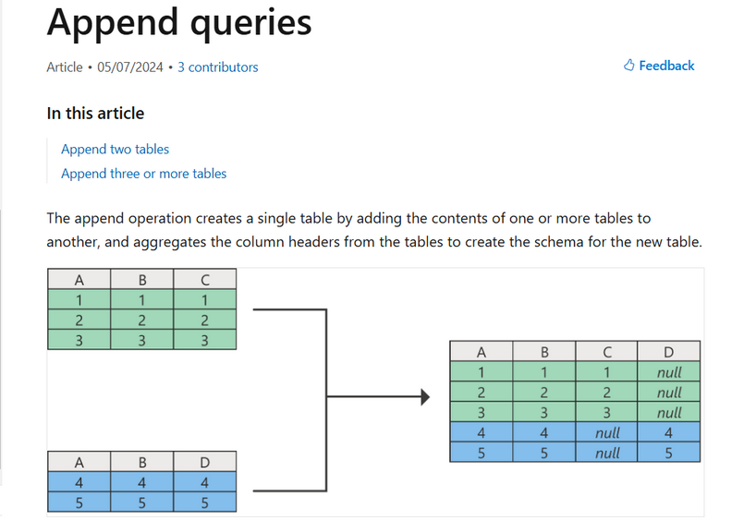
THE TWO TABLES NEED TO BE APPENDED AS WE NEED TO COMBINE THE RECORDS OF BOTH THE TABLES CONTAINING SAME COLUMN HEADERS

Slide 22
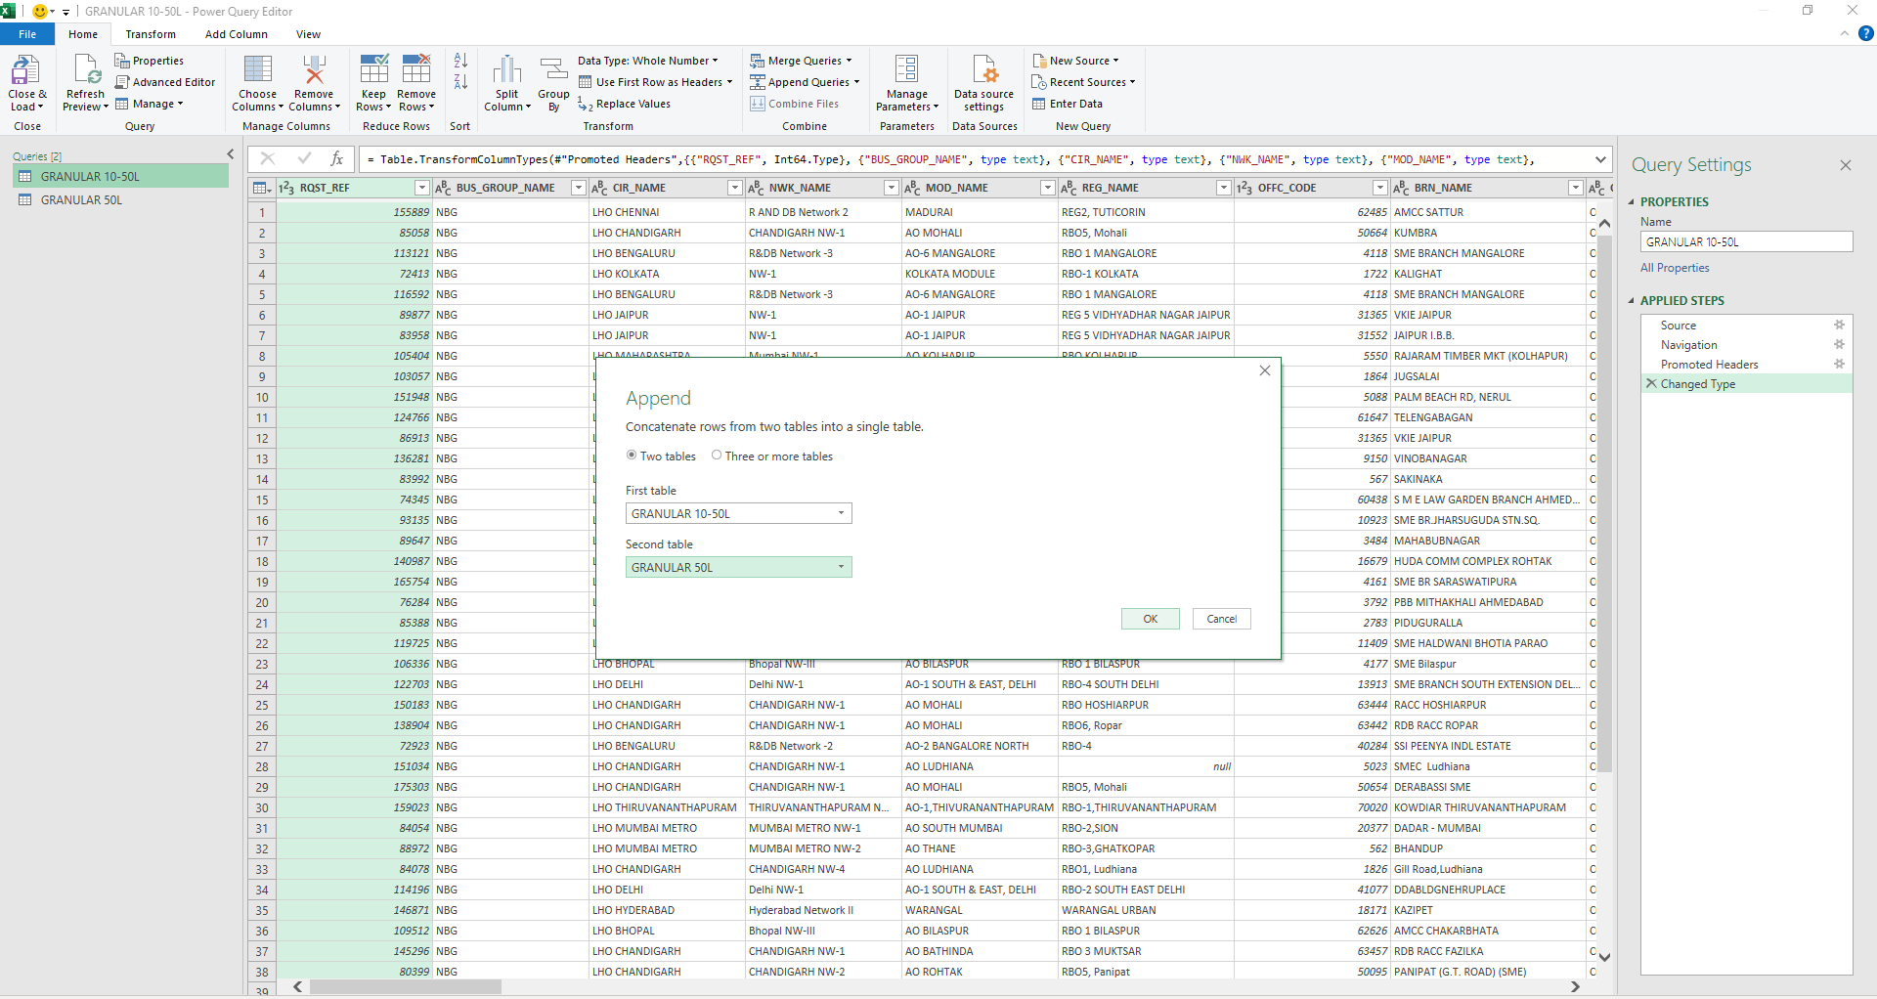
THE TWO TABLES NEED TO BE APPENDED AS WE NEED TO COMBINE THE RECORDS OF BOTH THE TABLES CONTAINING SAME COLUMN HEADERS

Slide 23
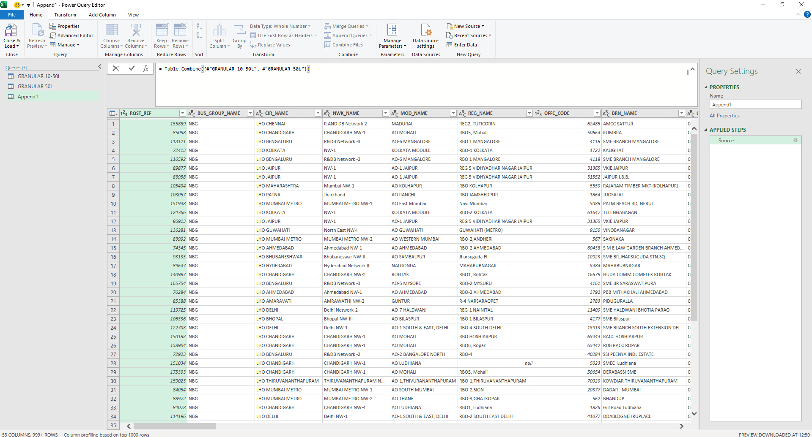
AFTER APPENDING THE COMBINED TABLE LOOKS LIKE THIS

Slide 24
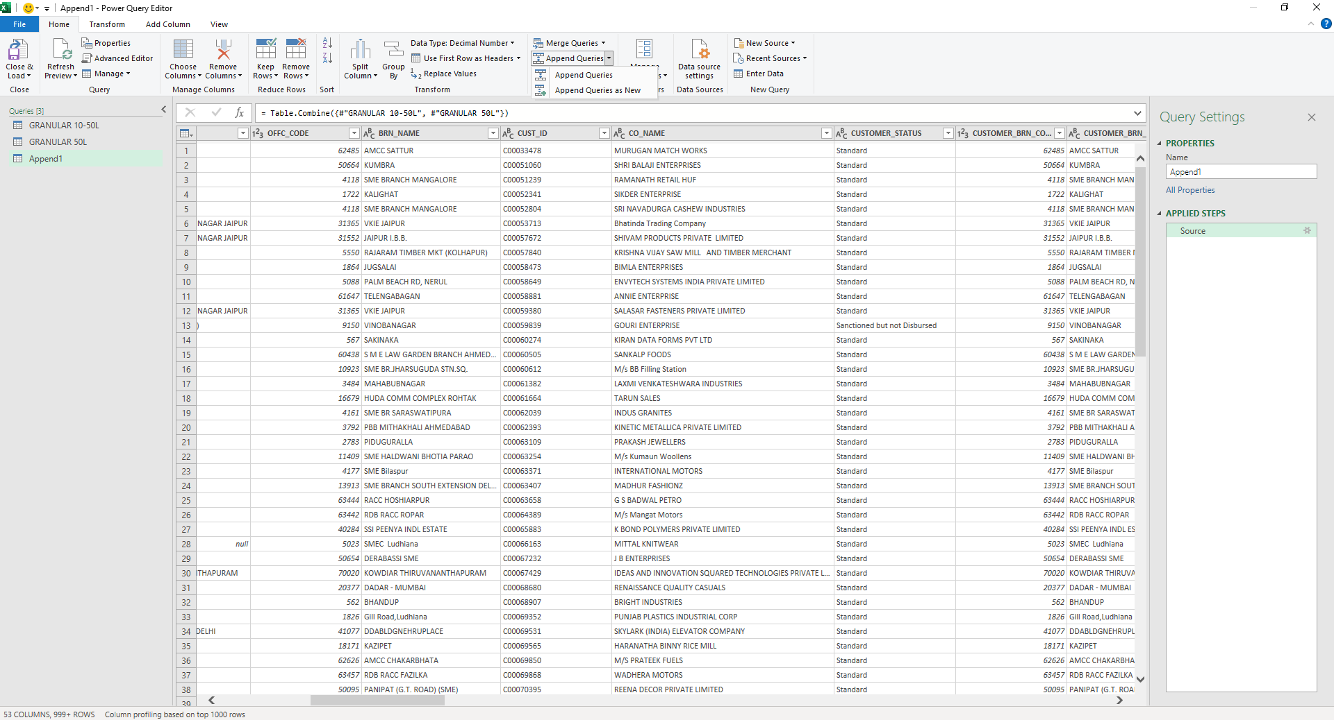
AFTER APPENDING THE COMBINED TABLE LOOKS LIKE THIS

Slide 25
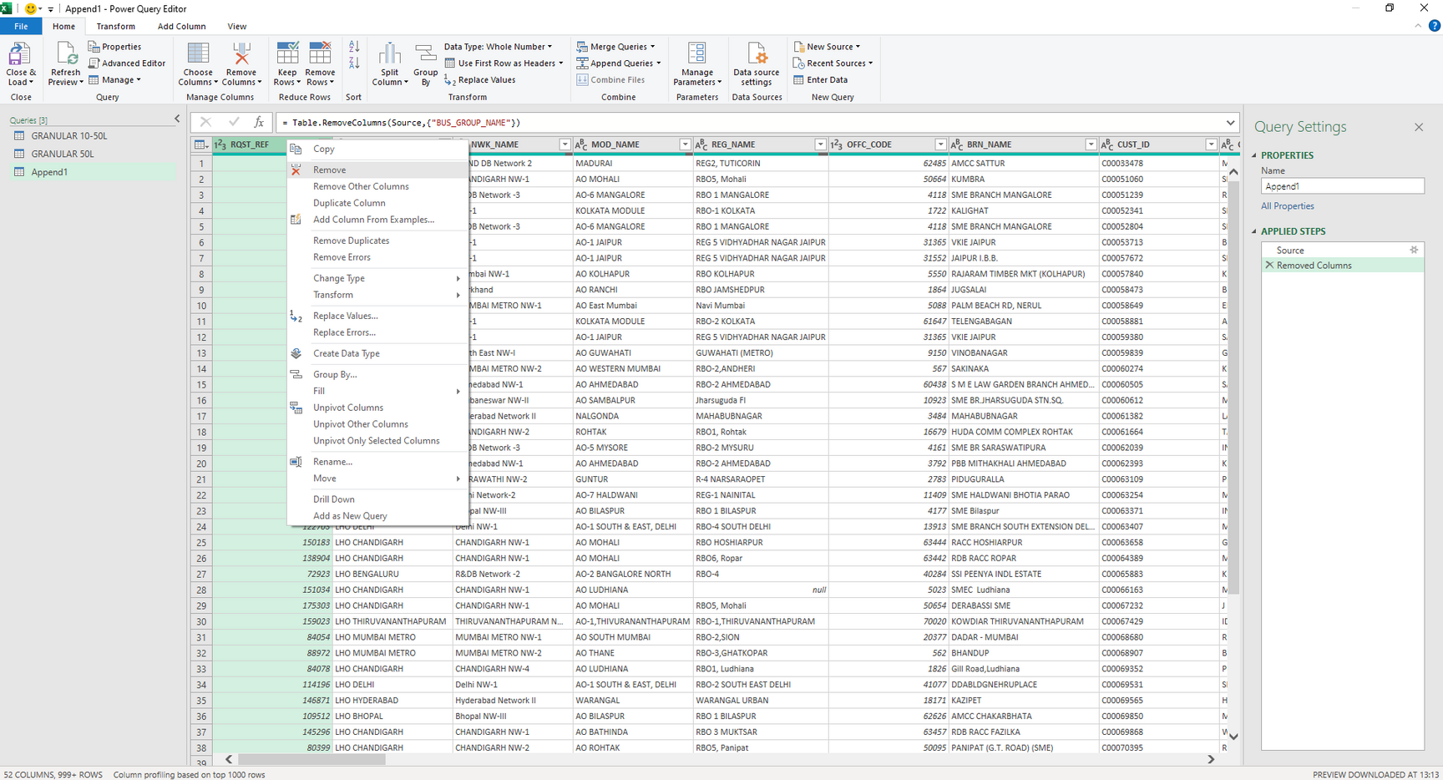
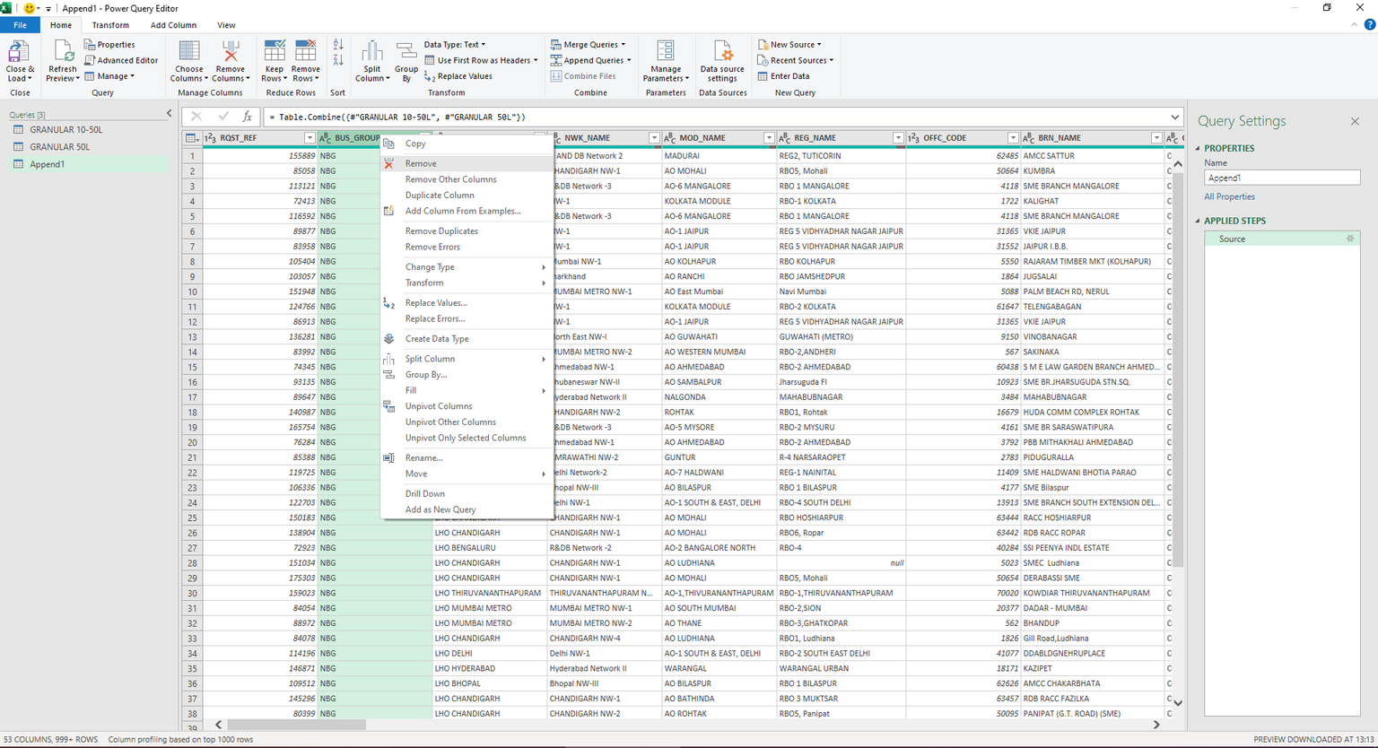
DATA CLEANING AND TRANSFORMATION PROCESS
REMOVED THE COLUMNS WHICH ARE NOT REQUIRED

Slide 26
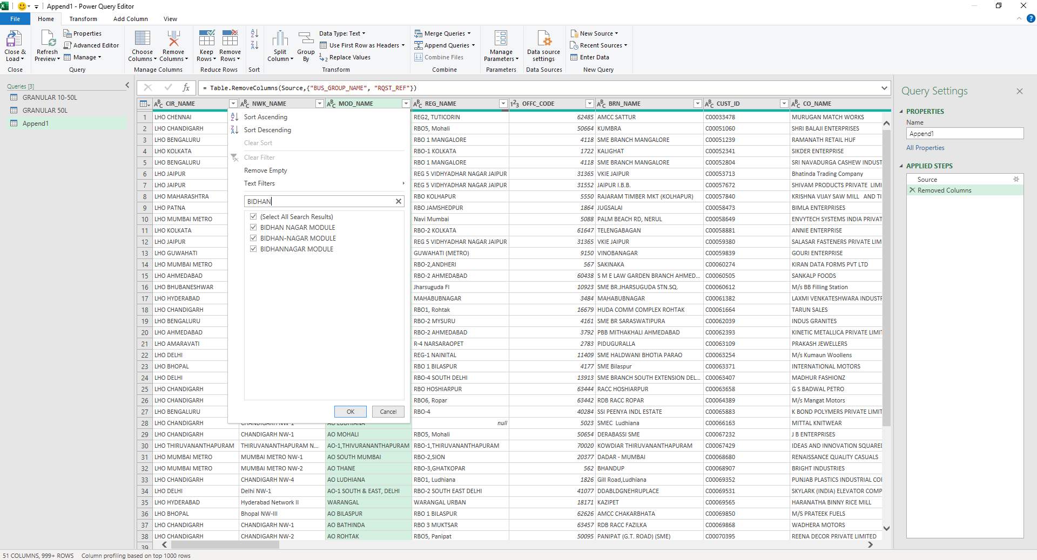
DATA CLEANING AND TRANSFORMATION PROCESS
WE NEED RECORDS OF OUR MODULE BIDHANNAGAR ONLY, SO FILTER APPLIED IN THE MOD_NAME COLUMN BY SEARCHING THE WORD “BIDHAN”.

Slide 27
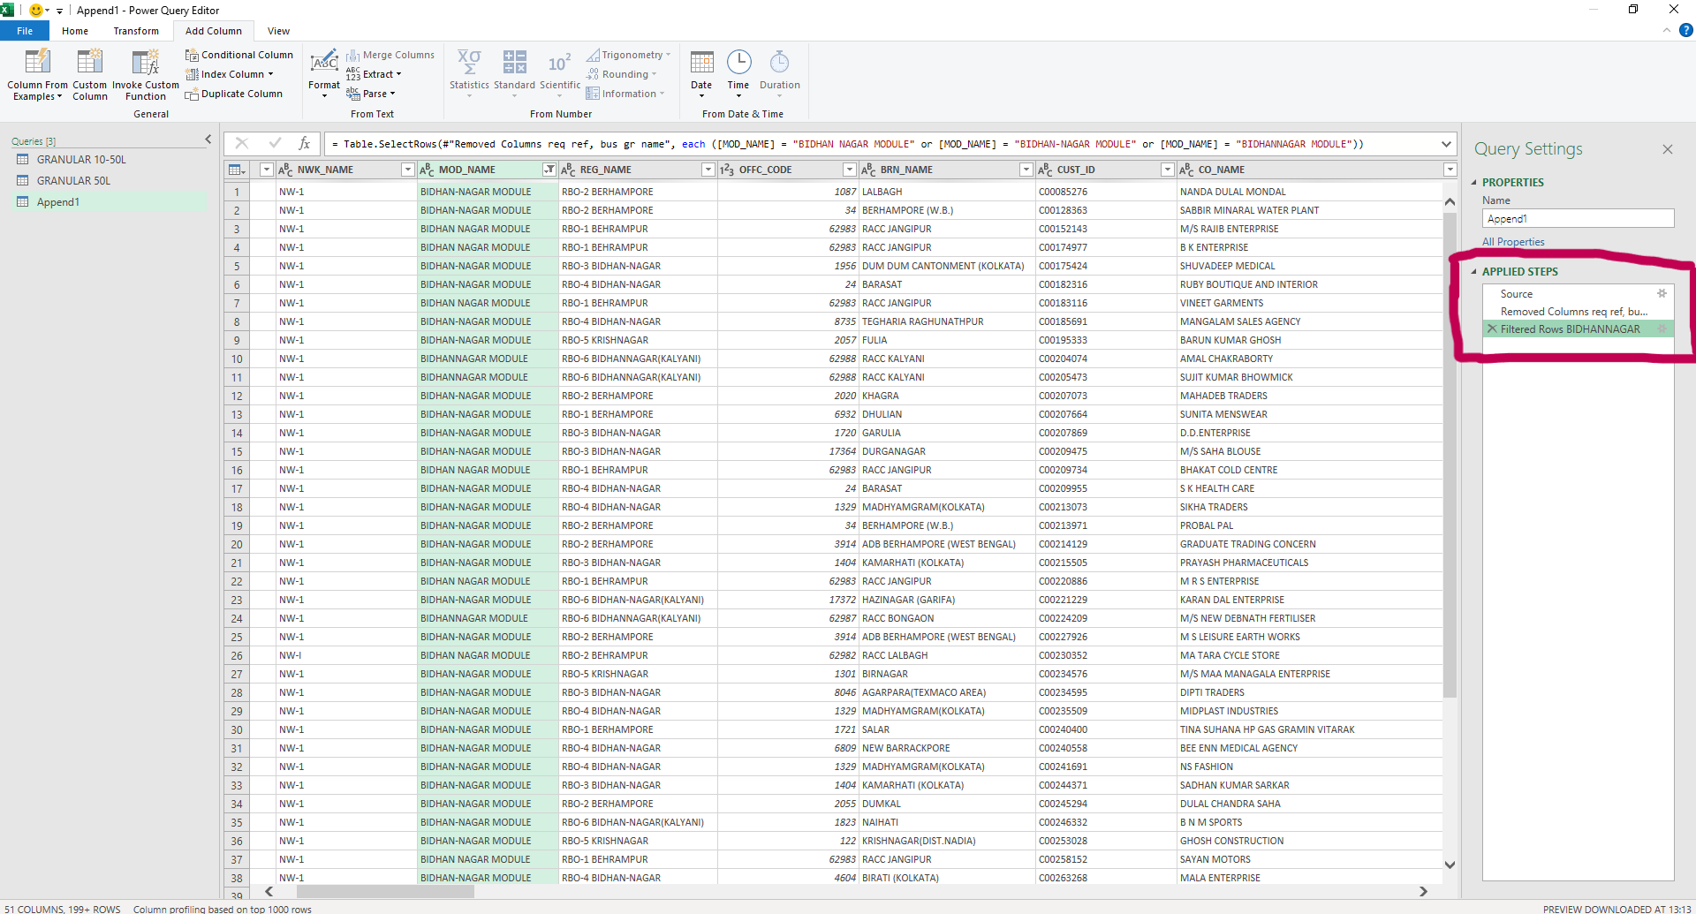
DATA CLEANING AND TRANSFORMATION PROCESS
ALSO EACH STEP APPLIED ARE RENAMED FOR FUTURE REFERENCE. IT IS CONSIDERED A BEST PRACTICE.
THE DATA IS FILTERED ACCORDINGLY.

Slide 28
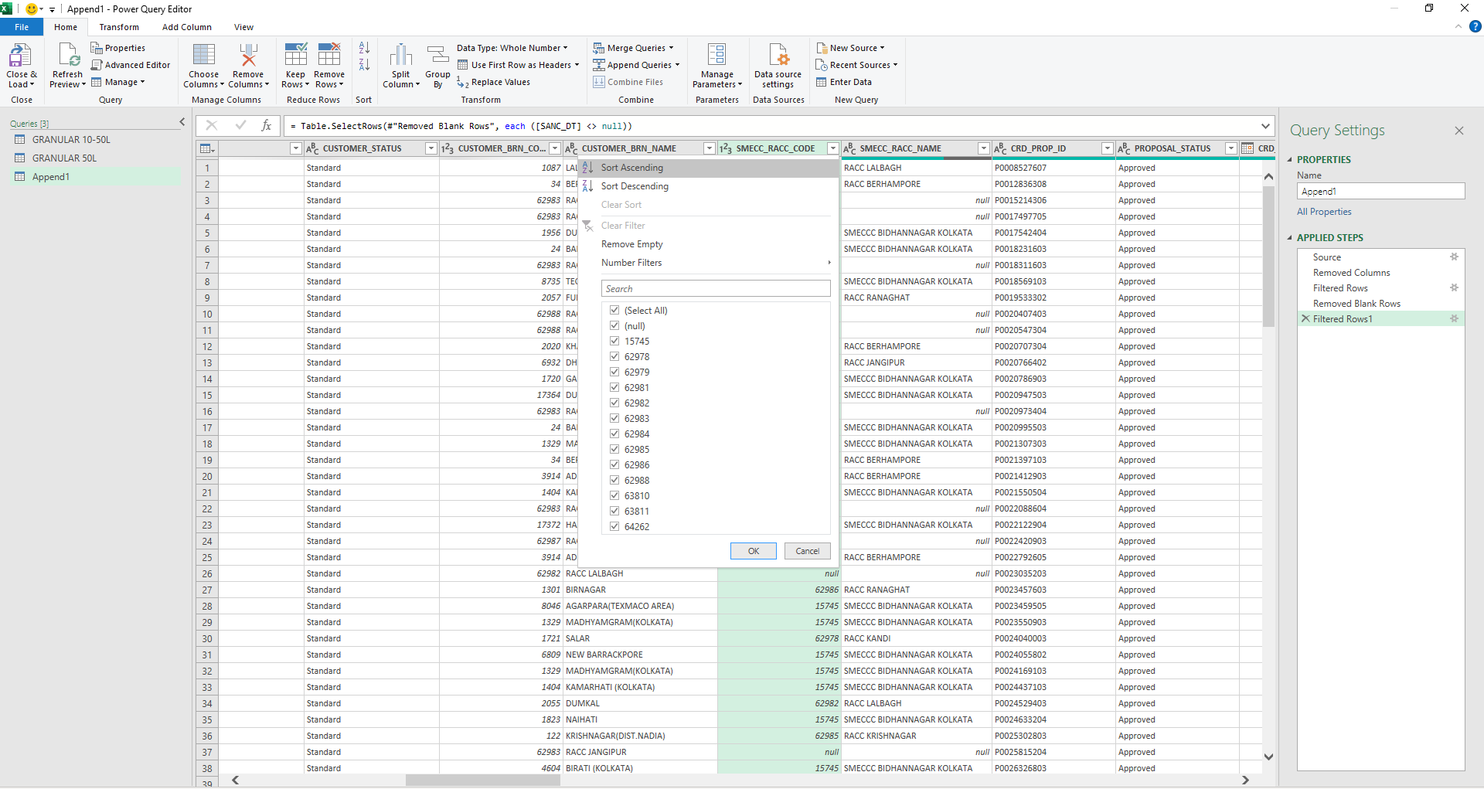
DATA CLEANING AND TRANSFORMATION PROCESS
THERE ARE NULL VALUES IN SMECC_RACC_CODE COLUMN.

Slide 29
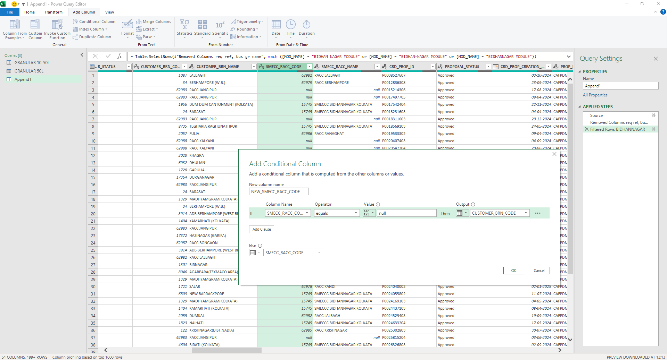
DATA CLEANING AND TRANSFORMATION PROCESS
CONDITIONAL COLUMN ADDED TO REPLACE THE NULL VALUES WITH THAT OF ANOTHER COLUMN “CUSTOMER_BRN_CODE”

Slide 30
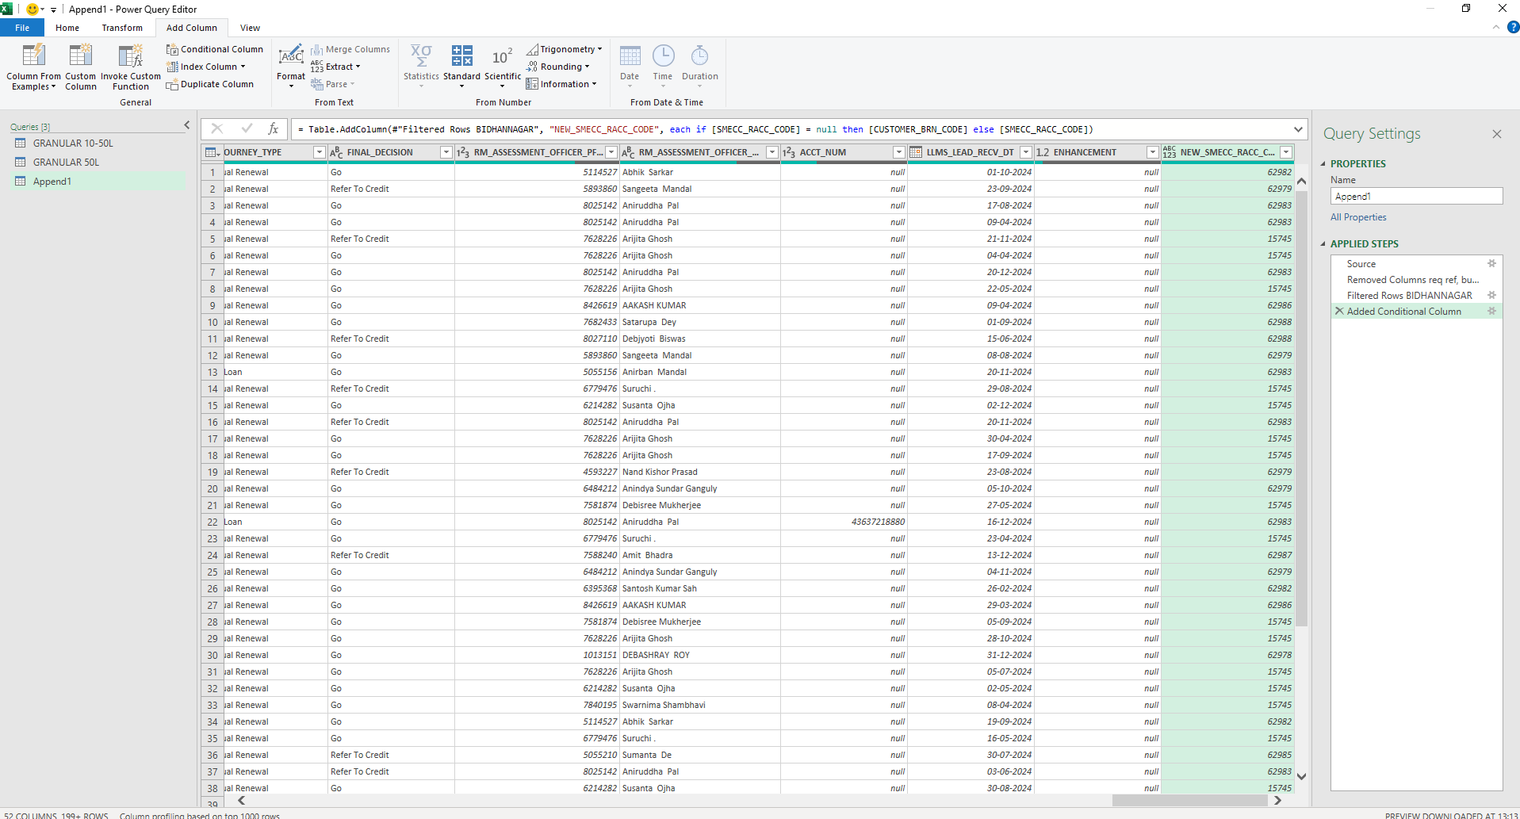
DATA CLEANING AND TRANSFORMATION PROCESS
NEW CONDITIONAL COLUMN WITH NULL VALUES REPLACED WITH BRANCH CODE ADDED.

Slide 31
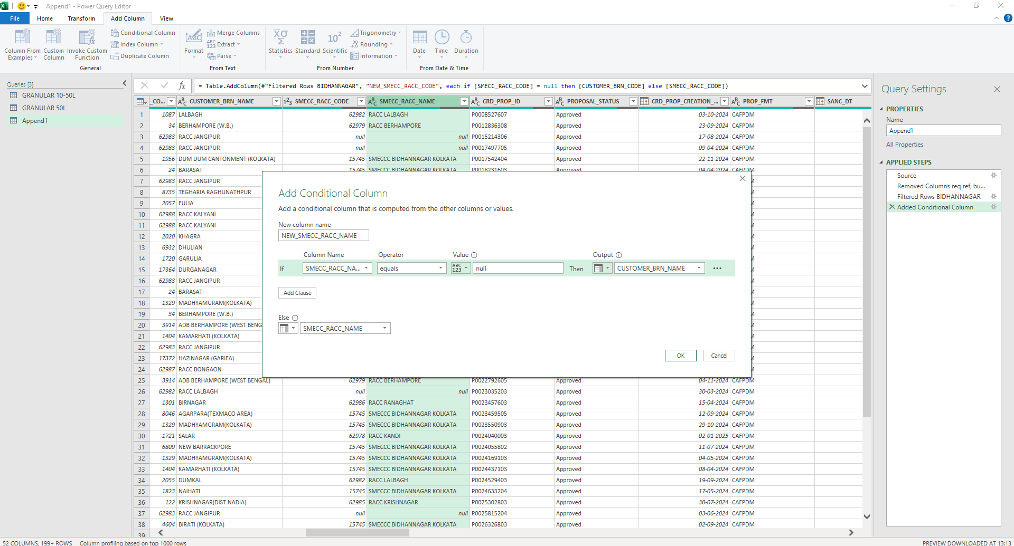
DATA CLEANING AND TRANSFORMATION PROCESS
IN THE SAME WAY NULL VALUES FROM COLUMN “SMECC_RACC_NAME” REPLACED WITH THAT OF ANOTHER COLUMN “CUSTOMER_BRN_NAME”.

Slide 32
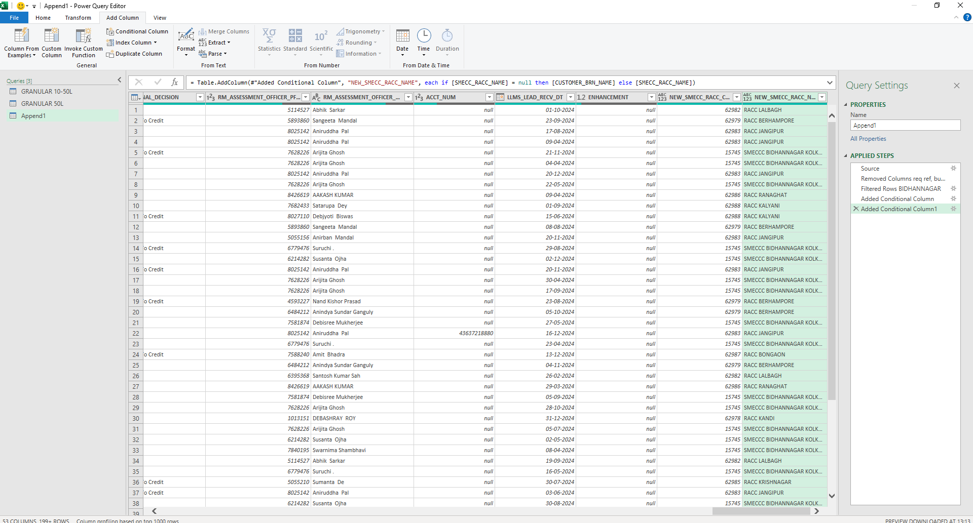
DATA CLEANING AND TRANSFORMATION PROCESS
NEW CONDITIONAL COLUMN WITH NULL VALUES REPLACED WITH BRANCH NAME ADDED IN THE LAST COLUMN.

Slide 33
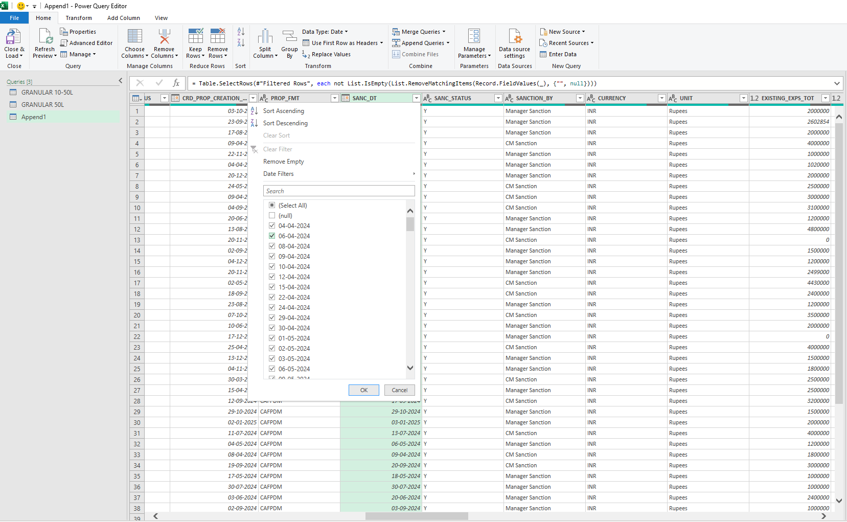
DATA CLEANING AND TRANSFORMATION PROCESS
THERE ARE NULL VALUES IN SANC_DT COLUMN. IT IS DESELECTED FROM THE SANC_DT COLUMN AND FILTERED.

Slide 34
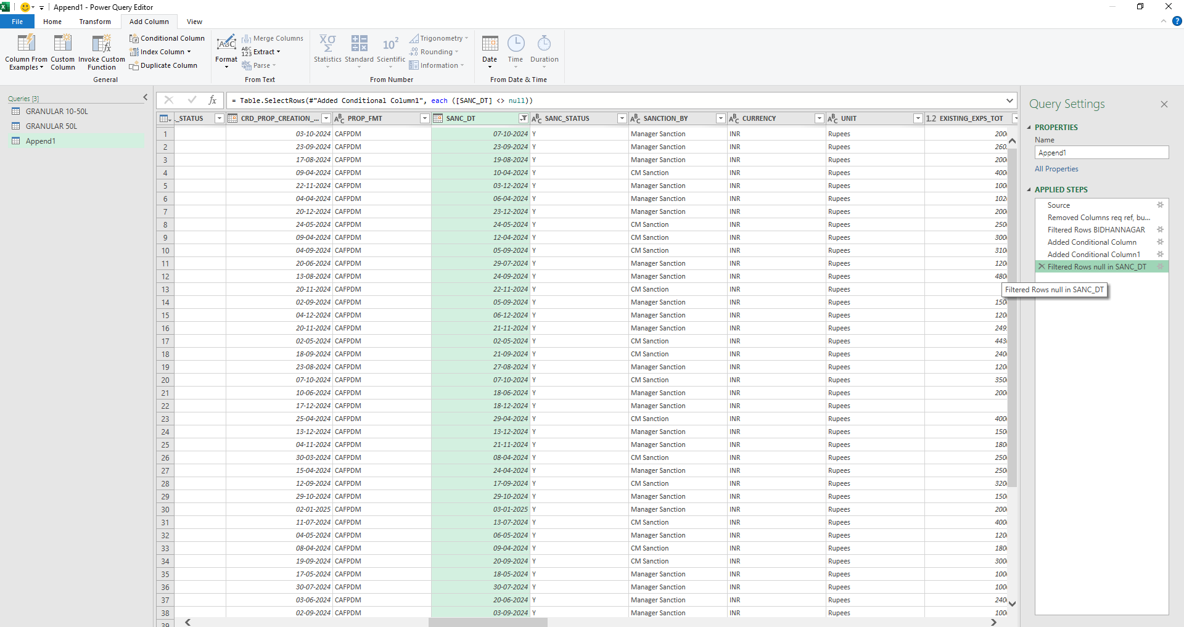
DATA CLEANING AND TRANSFORMATION PROCESS
FILTERED RESULT FROM SANC_DT COLUMN.

Slide 35
DATA CLEANING AND TRANSFORMATION PROCESS
WE SAW EARLIER WHILE APPLYING FILTER IN THE MOD_NAME, THERE WERE 3 TYPES OF BIDHANNAGAR MODULE NAME. THESE ARE TO BE REPLACED IN A SINGLE NAME “BIDHANNAGAR MODULE”.

Slide 36
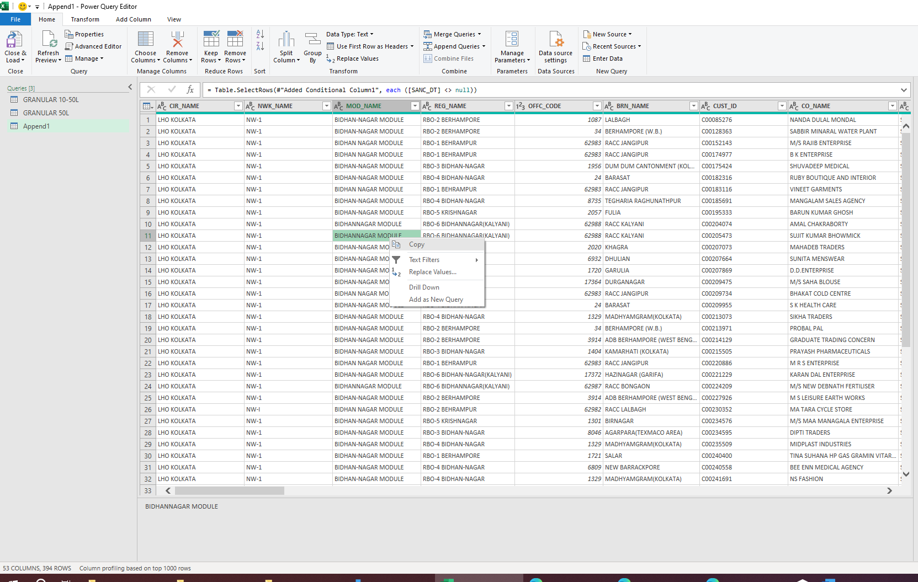
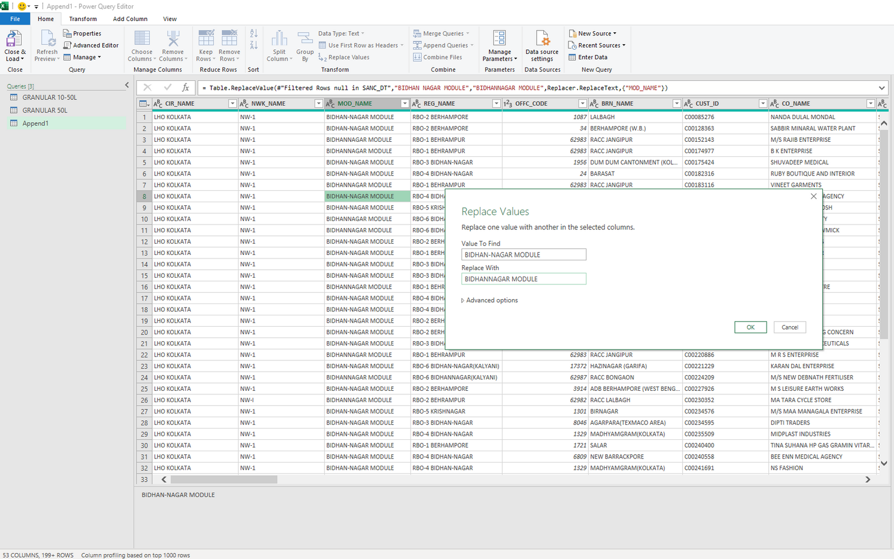
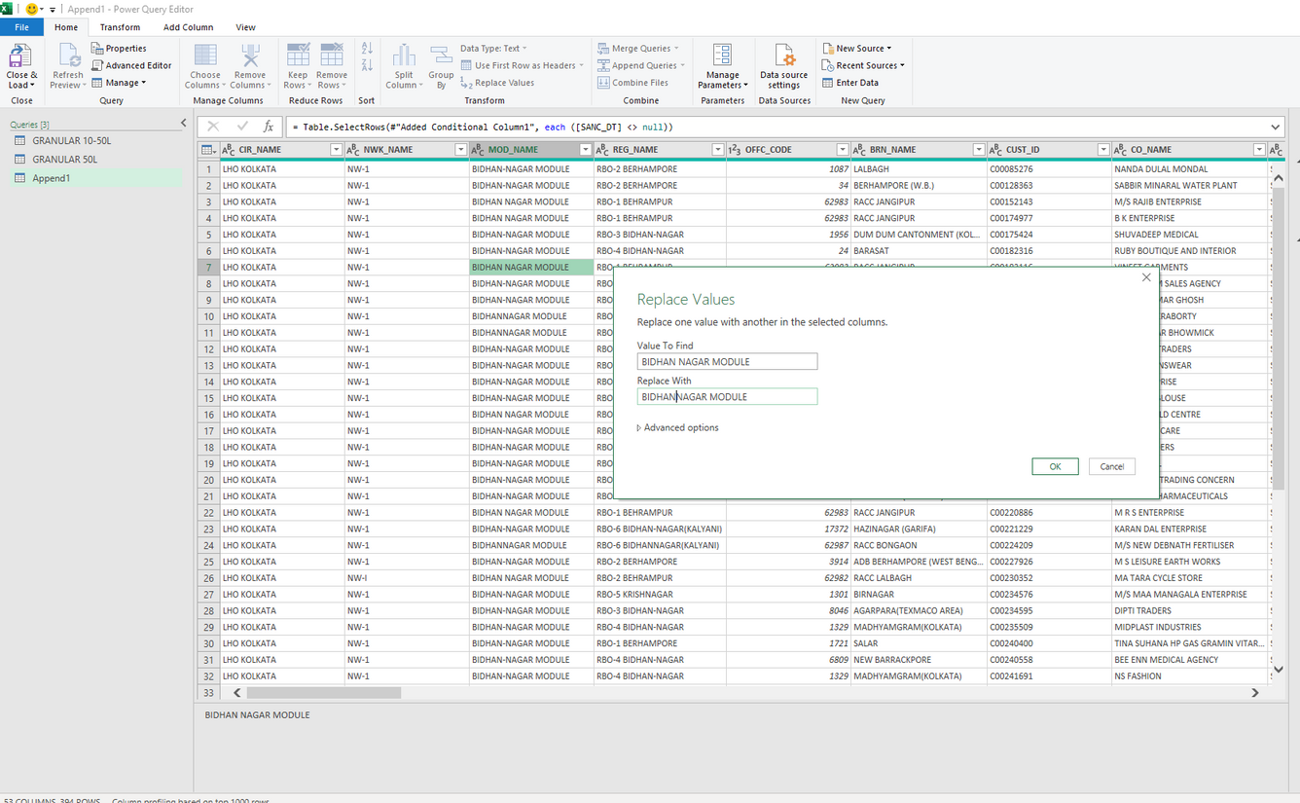
DATA CLEANING AND TRANSFORMATION PROCESS
EACH MODULE NAME COPIED AND REPLACED WITH TEXT “BIDHANNAGAR MODULE”

Slide 37
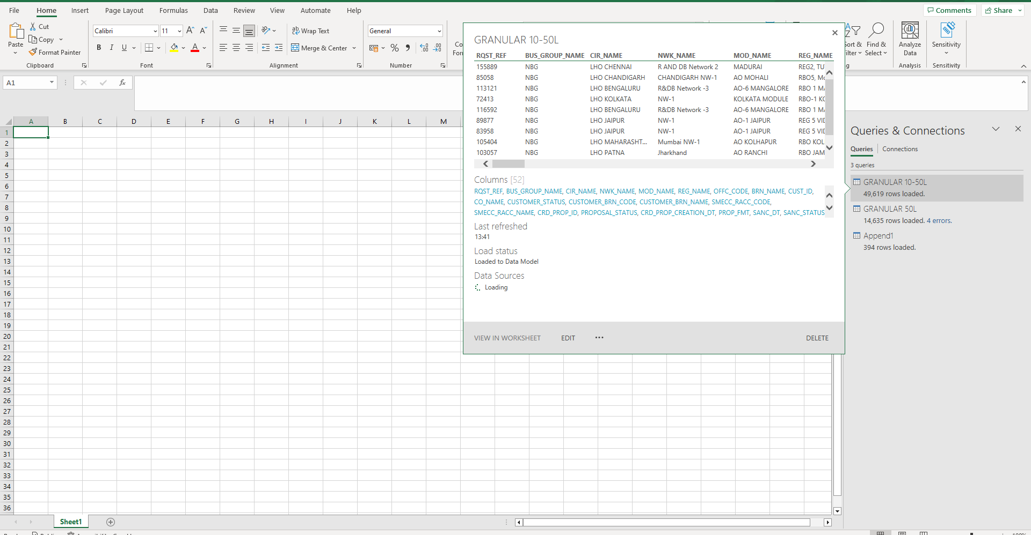
DATA CLEANING AND TRANSFORMATION PROCESS
FINALLY THE APPENDED TABLE CLOSED AND LOADED

Slide 38
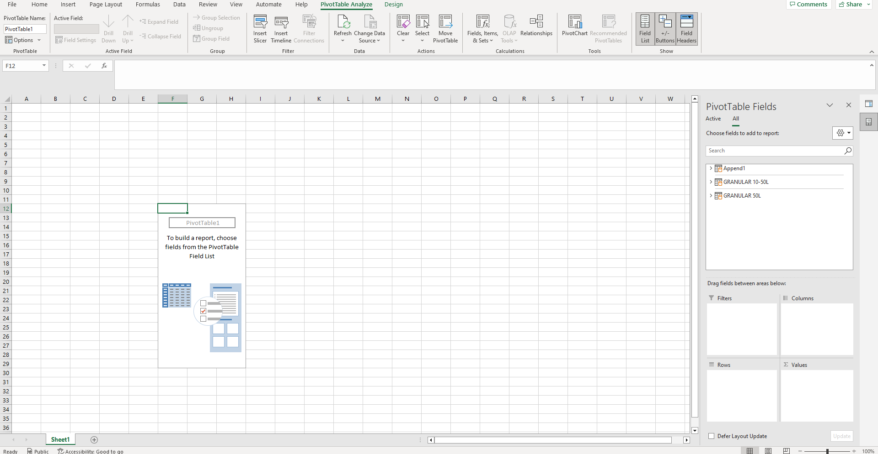
PIVOT TABLE CAN BE CREATED FROM INSERT-->CREATE PIVOT TABLE PATHWAY. WE SHALL WORK ONLY WITH THE APPENDED TABLE, SO WE DON’T NEED TO BUILD DATA MODEL IN THIS CASE.

Slide 39
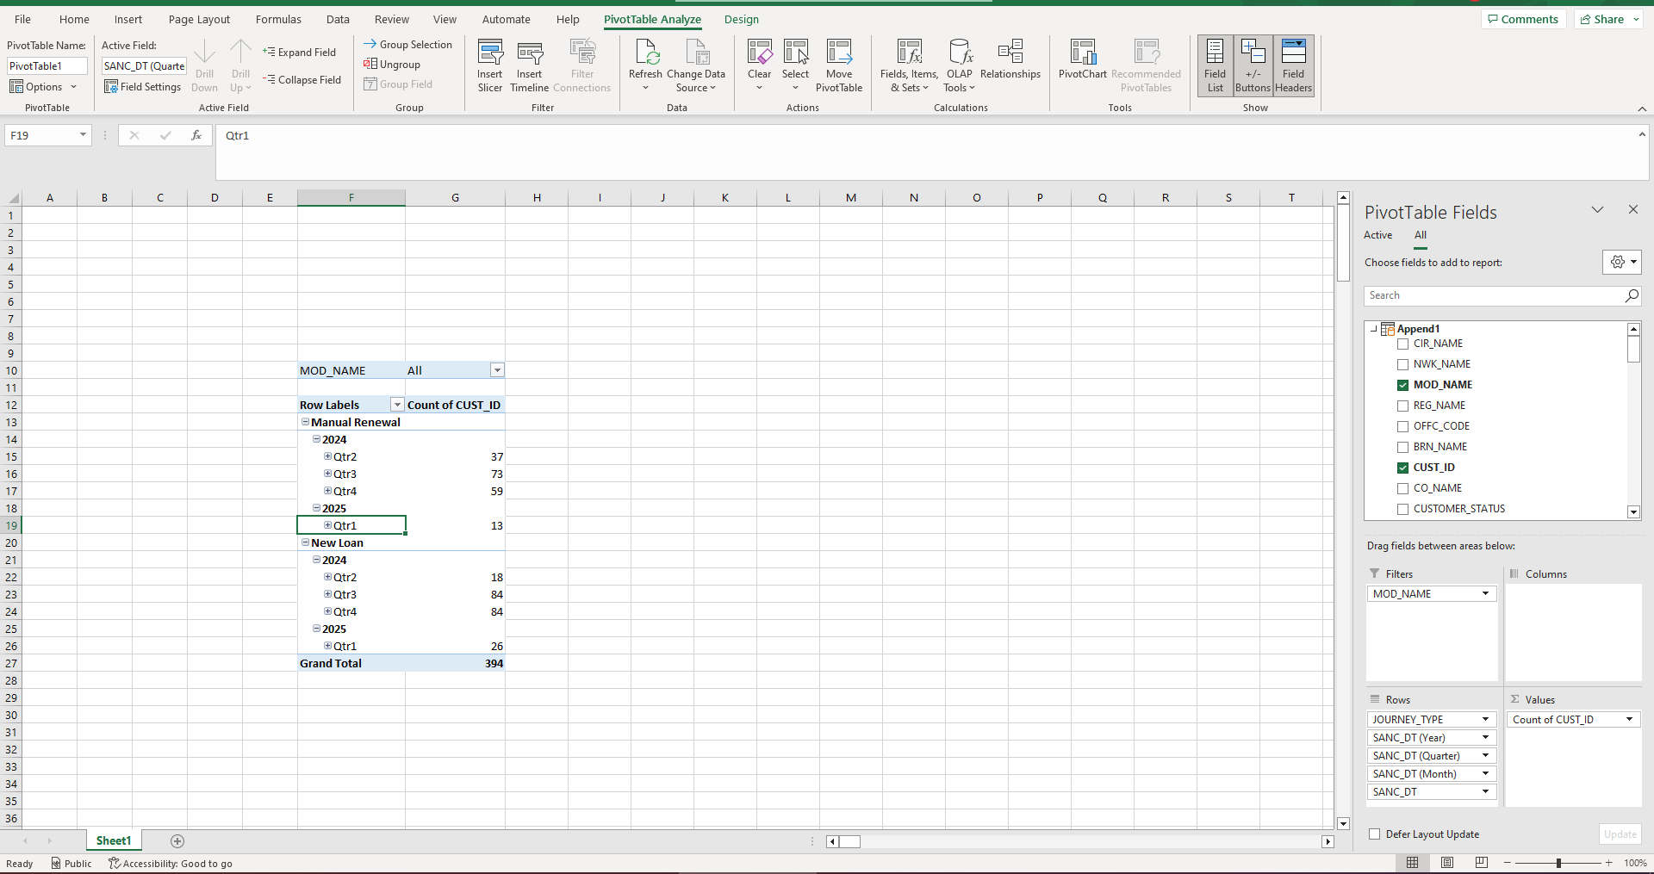
IN THE PIVOT TABLE IF THE SANC_DT IS PLACED IN THE ROWS, WE CAN GET THE QUARTERS, BUT THIS IS NOT CORRECT, AS THE QUARTER IS CALCULATED BASED ON CALENDER YEAR, BUT WE NEED QUARTER FROM THE YEAR AS MENTIONED IN THE DATA, WHICH IS FROM 01.04.2024 TILL REPORT DATE.

Slide 40
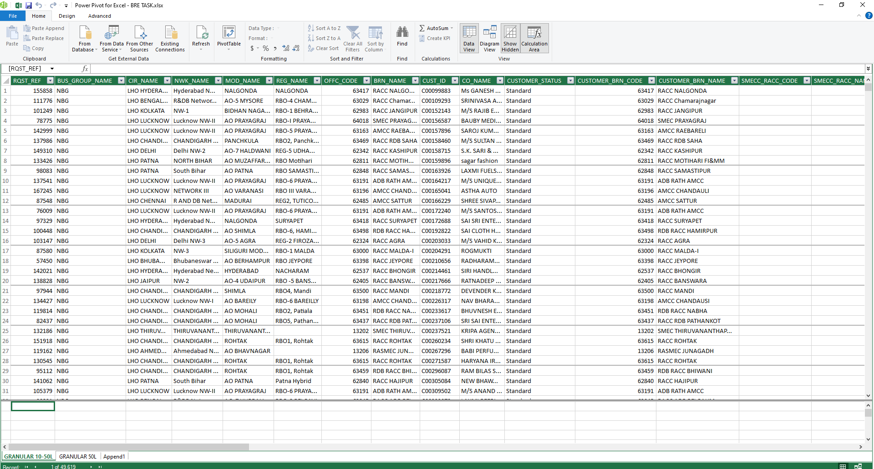
THE TABLES CAN BE VIEWED IN THE POWER PIVOT->DATA VIEW PAGE.

Slide 41
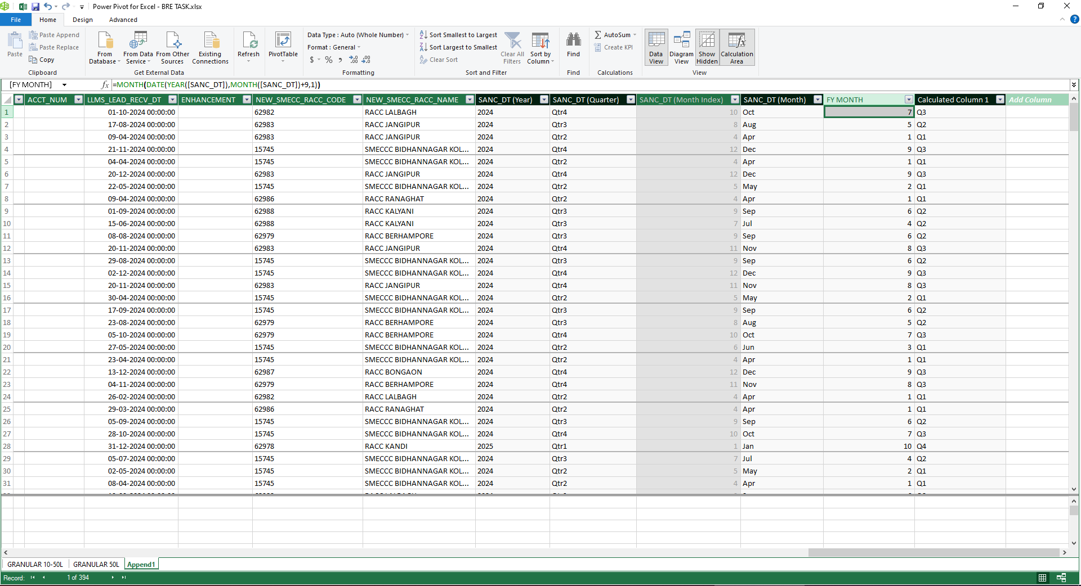
IN THE POWER PIVOT WE CAN SEE THE YEAR, QTR AND MONTH IS CREATED BY PIVOT TABLE.
WE ADDED A NEW COLUMN “FY_MONTH” FROM “SANC_DT”USING THE FORMULA. WE CAN SEE THE“FY_MONTH” IS DIFFERENT THAN THE MONTH COLUMN BY PIVOT.

Slide 42
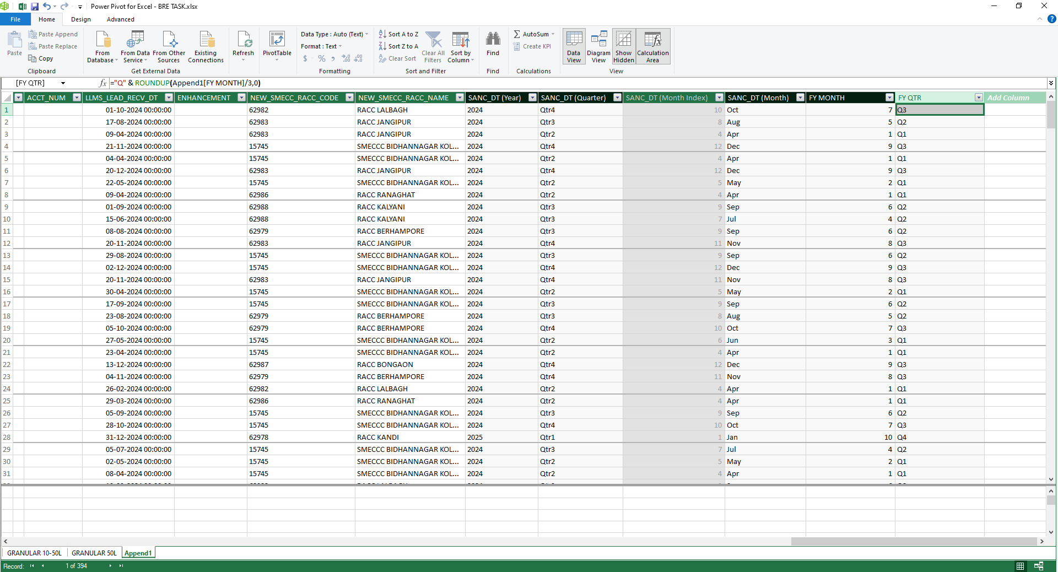
NOW A NEW COLUMN “FY_QTR” CREATED USING THE FORMULA AS SHOWN TO GET THE QUARTER FROM THE DATE MENTIONED IN THE DATASET.

Slide 43
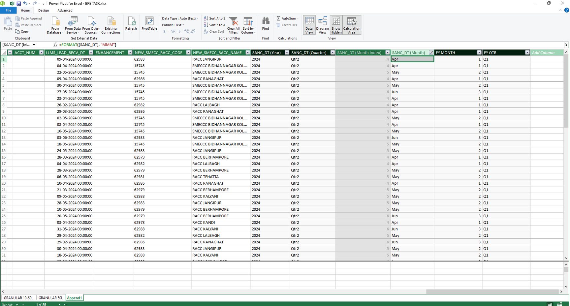
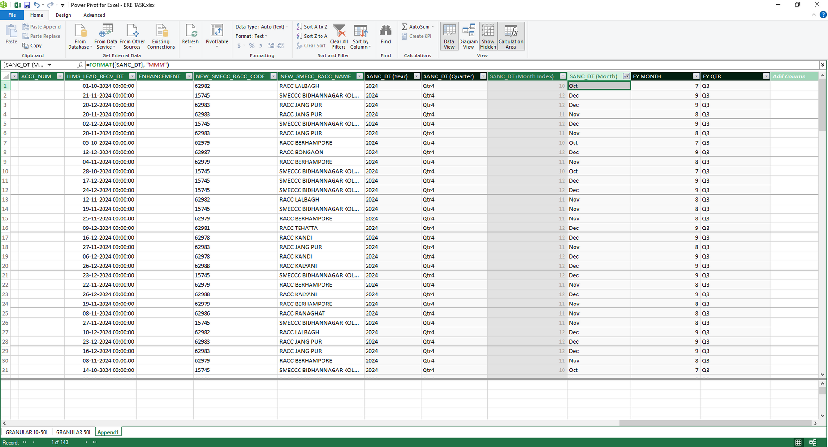
TO CHECK THE CORRECTNESS OF THE RESULT, SANC_DT (MONTH) CAN BE FILTERED AND ACCORDINGLY QTR CAN BE CHECKED IN THE FY_QTR COLUMN.

Slide 44
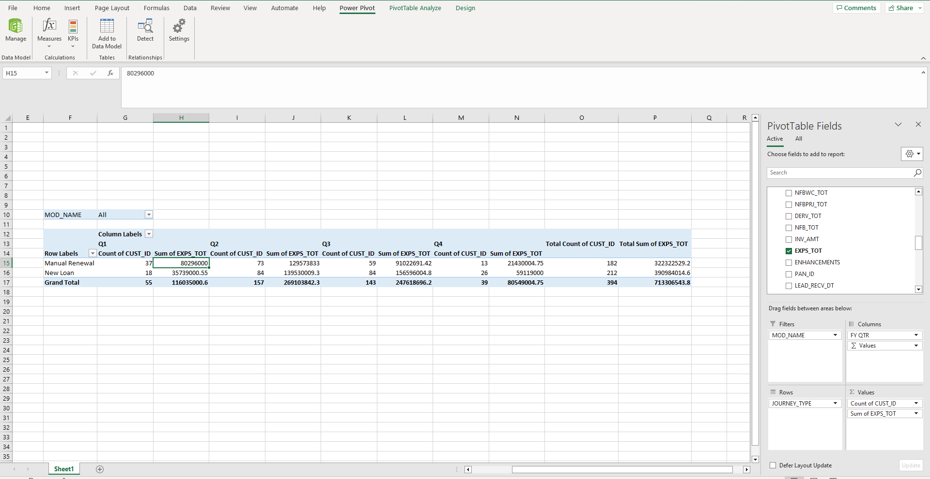
PIVOT TABLE CREATED WITH THE CORRECT VALUES AND NOW REPORT CAN BE PREPARED.

Slide 45
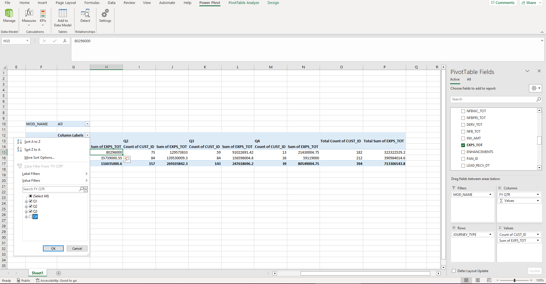
WE DON’T NEED Q4 DATA, SO IT IS DESELCTED FROM THE COLUMN LABELS.

Slide 46
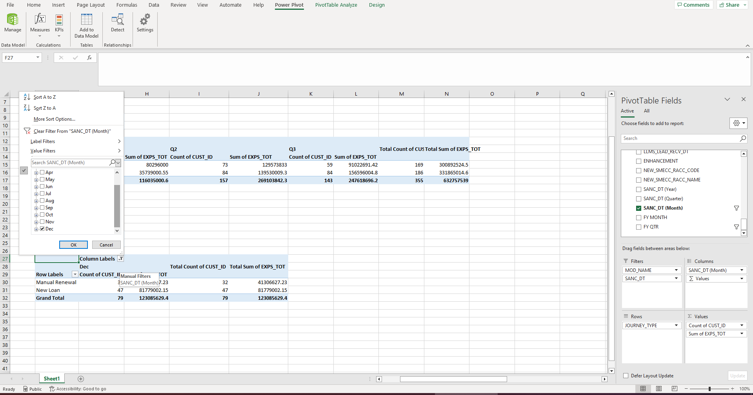
TO GET THE MTD DEC-24 DATA, THE PIVOT TABLE IS COPIED BELOW, AND ONLY DEC IS SELECTED.

Slide 47
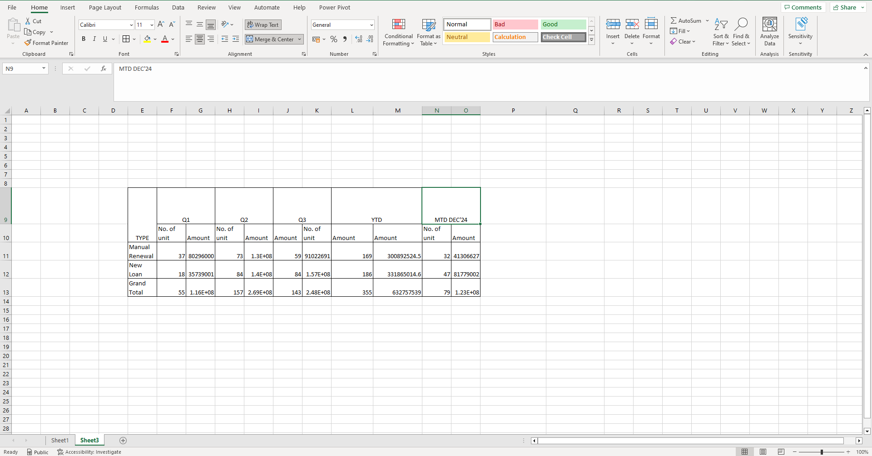
NOW THE PIVOT TABLES ARE COPIED AND PASTED (PASTE SPECIAL) IN A NEW SHEET FOR FINE TUNING THE REPORT.

Slide 48
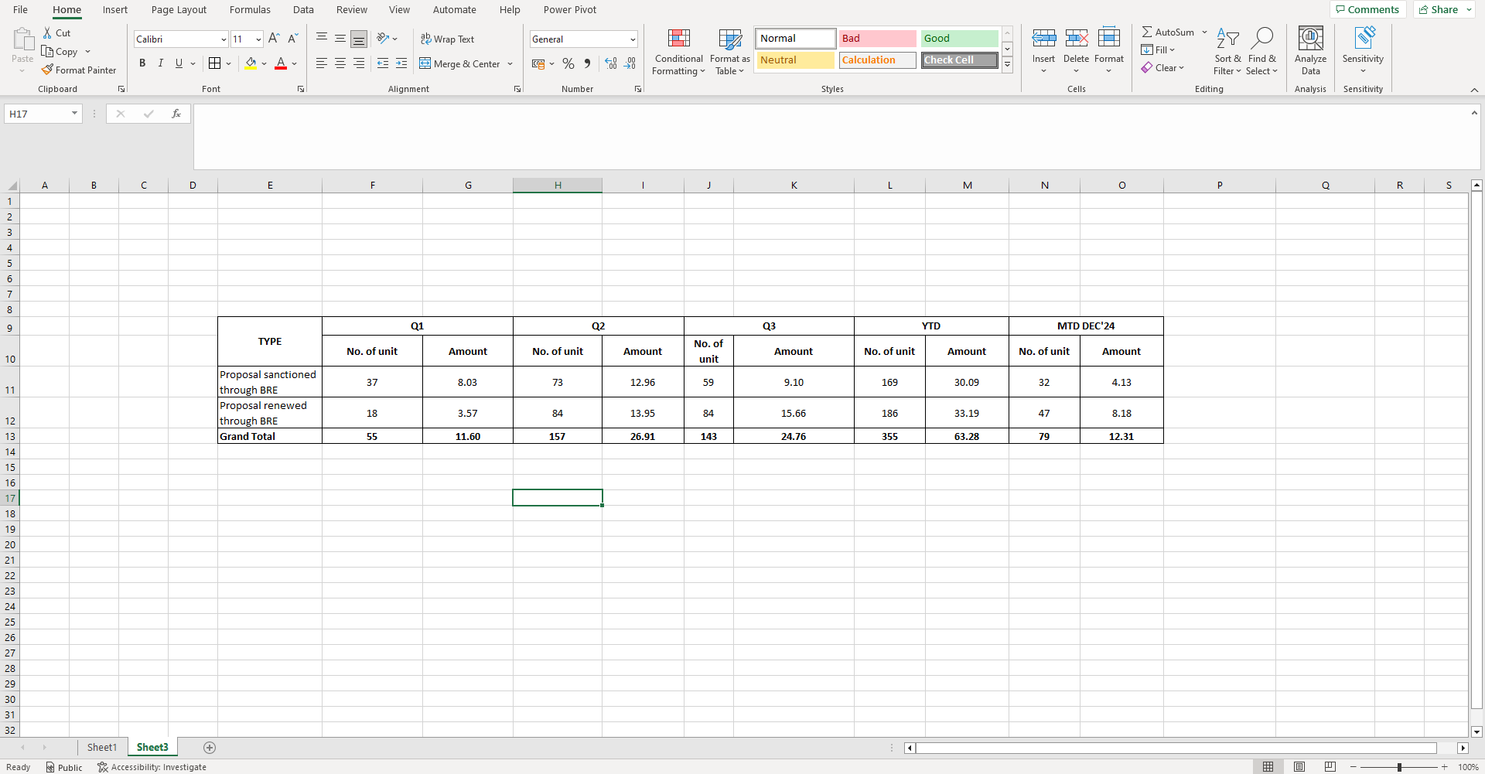
FINE TUNING IS DONE BY FORMATTING THE CELLS WITH BORDER, CHANGING FONTS, MERGING CELLS, CHANGING CELL HEIGHT, CHANGING THE AMOUNT TO 2 DECIMALS.

Slide 49
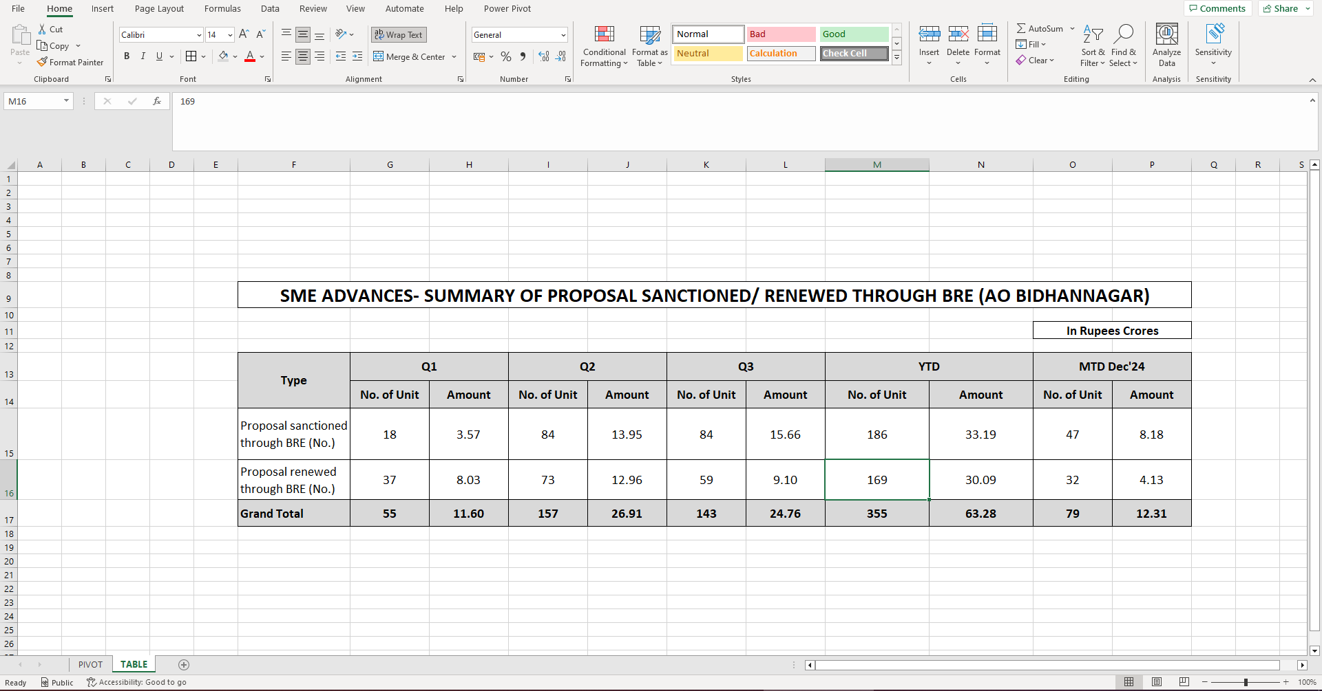
THIS IS THE FINAL REPORT AFTER NECESSARY FORMATTING IS DONE. IT IS NOW READY TO PRINT AND SUBMIT.

Slide 50
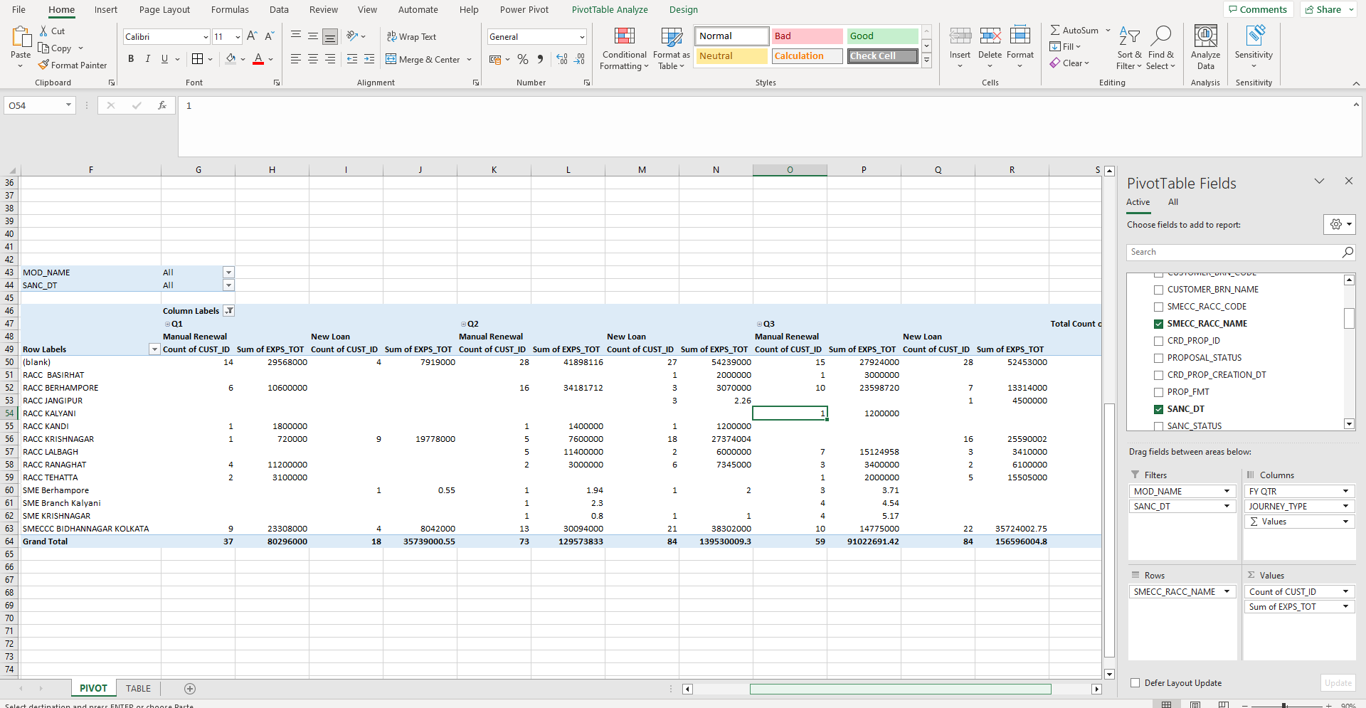
TO GET THE CPC WISE REPORT THE “NEW SMECC_RACC_NAME” IS PLACED IN THE ROWS, “JOURNEY_TYPE” PLACED IN THE COLUMNS.

Slide 51

THE FINAL CPC WISE REPORT AFTER NECESSARY FORMATTING.
RACC NOW RENAMED AS AMCC

Slide 52
THANK YOU
ARUNIMA PAUL

